Slide 1
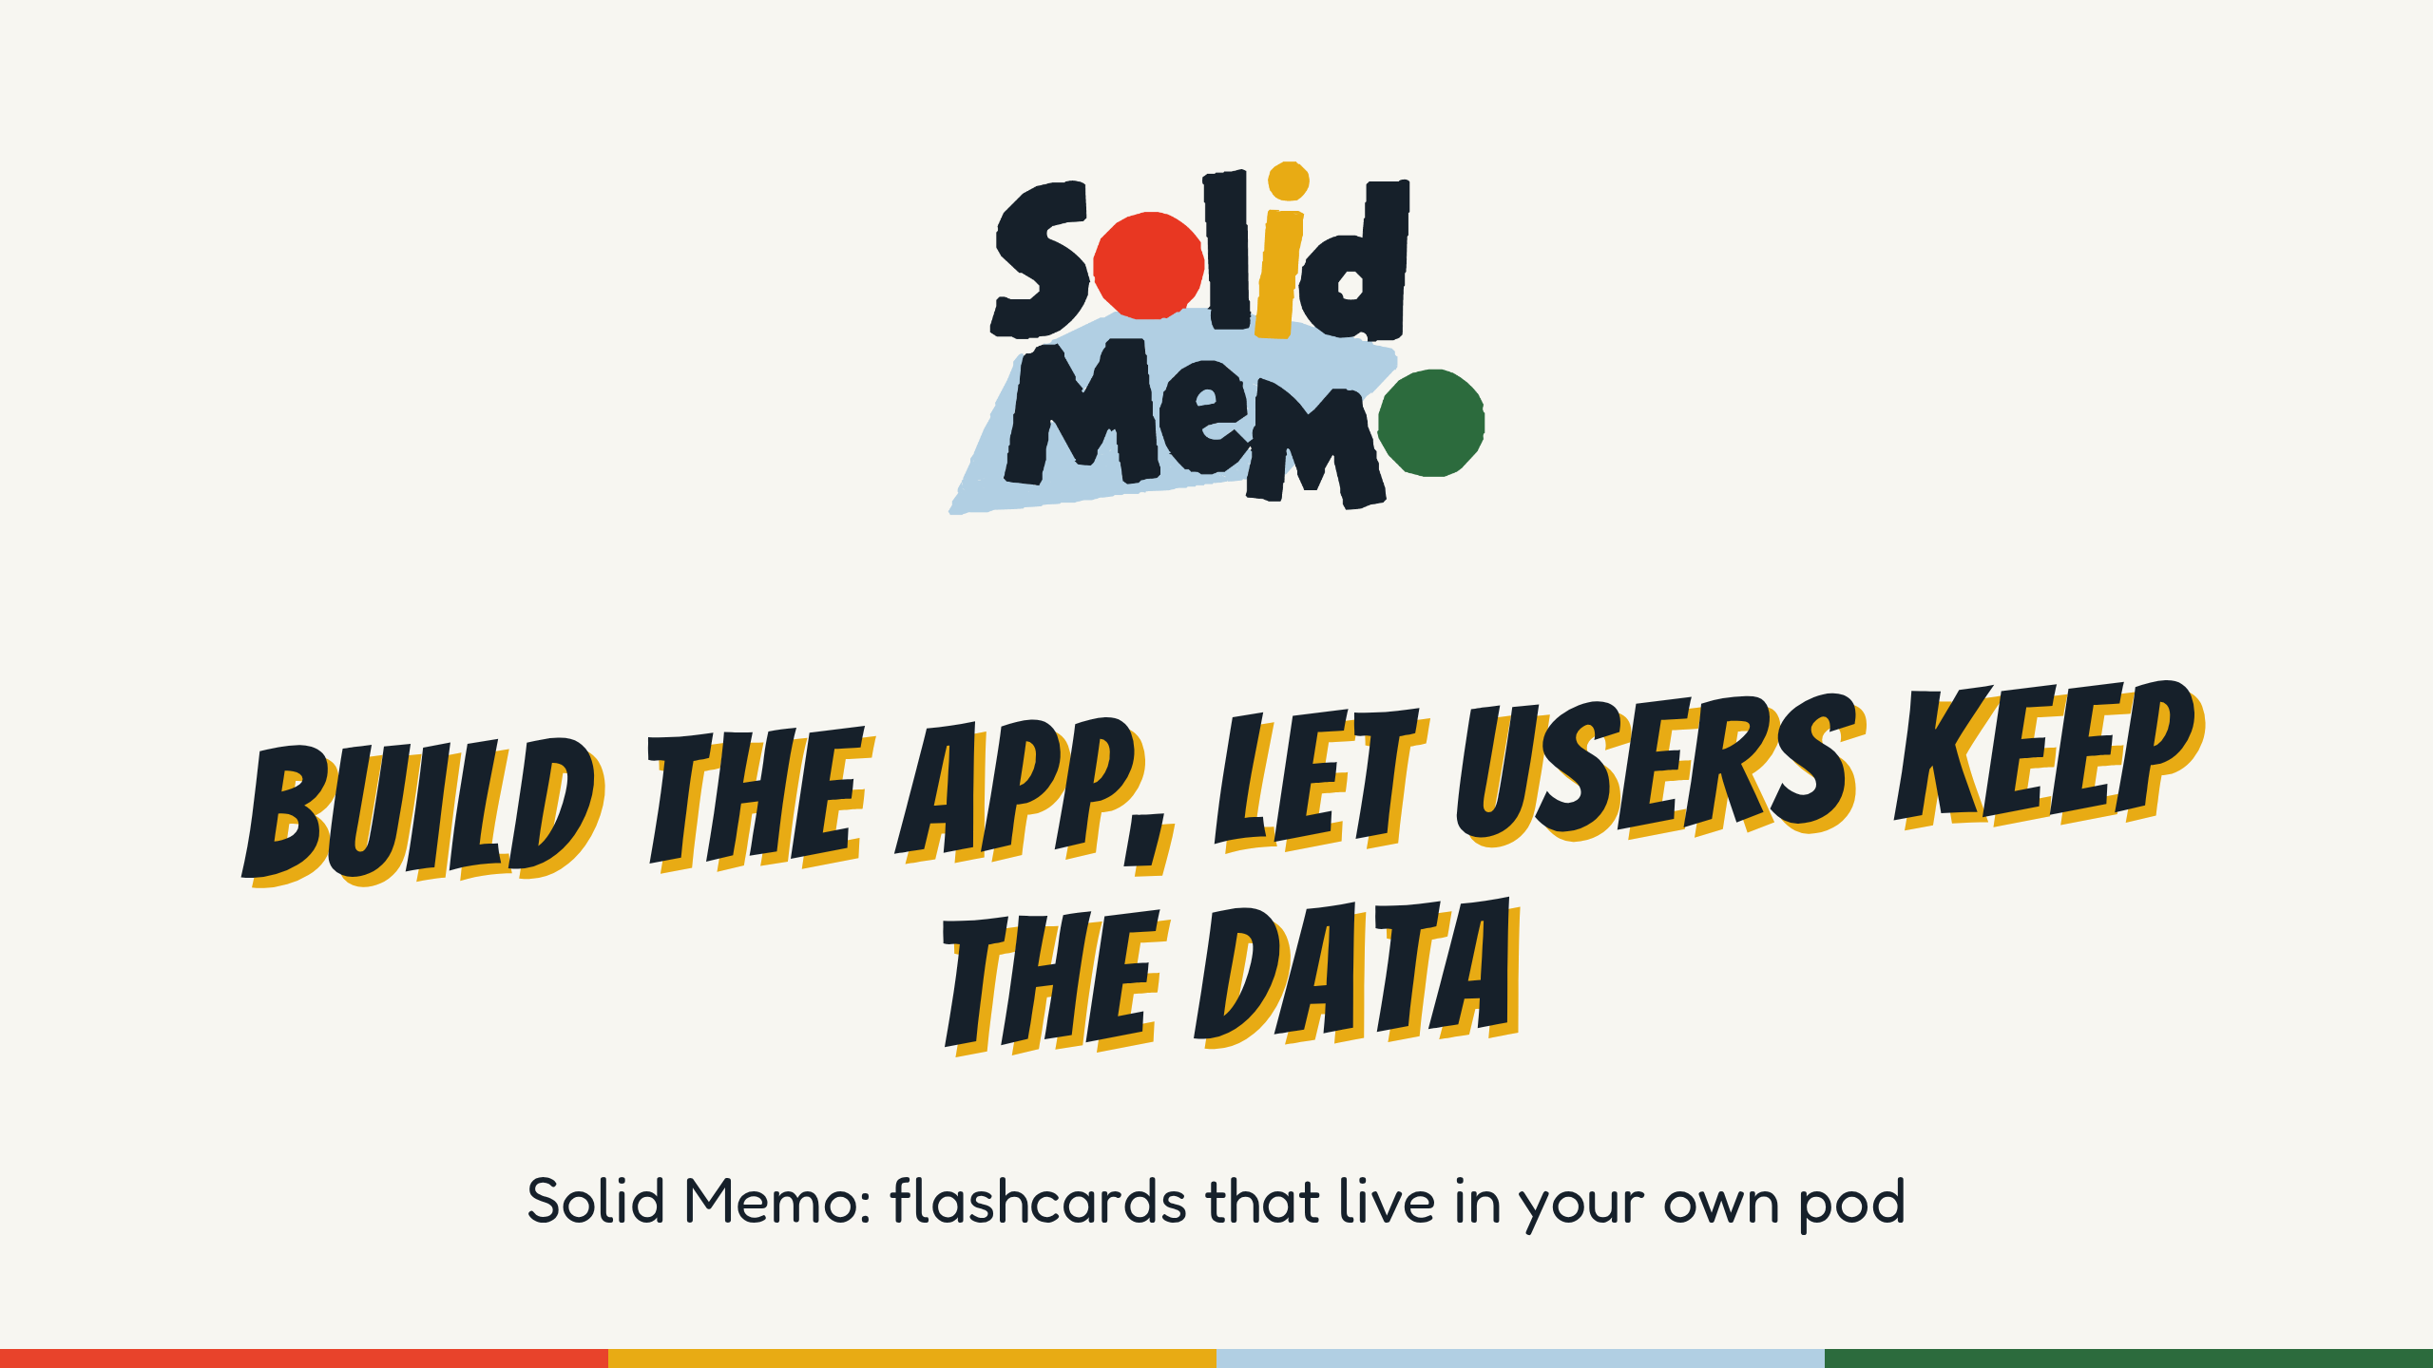
Notes:
Hi, I'm Anton. For the next 40 minutes: a flashcard app, why I built it the way I did, and what it shows about building apps on Solid.
The tagline under the title is the app's own: "Spaced-repetition flashcards that live in your own Solid Pod." By the end you'll know what each word in it means.
Everything in this talk is open, at github.com/solid-memo/talks: the slides and these notes under CC BY 4.0, the app's screenshots and logo under MIT.
(If you aren't Anton: the first-person story in these notes is the maintainer's. Tell it as his, or in your own words. Check the figures the notes mark before the talk: they were checked again on November 4, 2026, at version 6.29.18.)
(For an audience that already builds on Solid, give the other talk, "Nine server setups, no server of its own", in 2026-solid-memo-practitioners.)

Slide 2
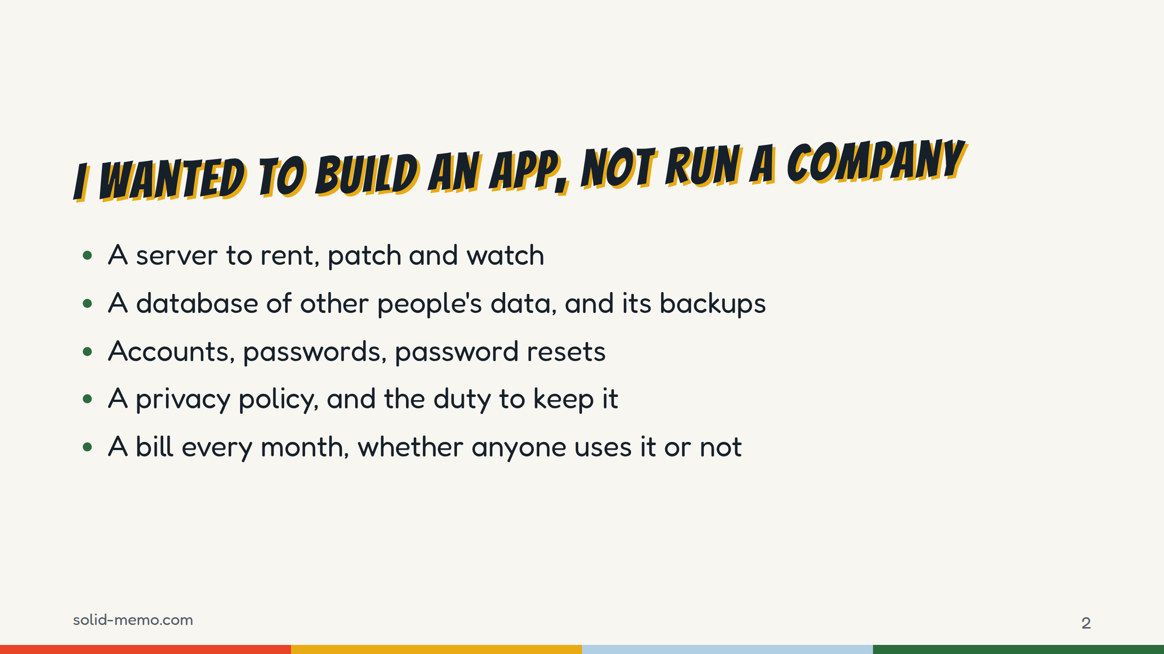
Notes:
(Tell this in your own words. This is the story the talk hangs on.)
I like building apps. What I don't want is everything that comes with running one: servers to patch at night, a database full of other people's study history, backups, password resets, and the legal weight of holding personal data. Plus a bill that keeps coming even if nobody uses the app.
For a hobby project, that's the point where most of us give up, or put it behind a subscription.
So the question I started with: can I build a real app and skip all of that?

Slide 3
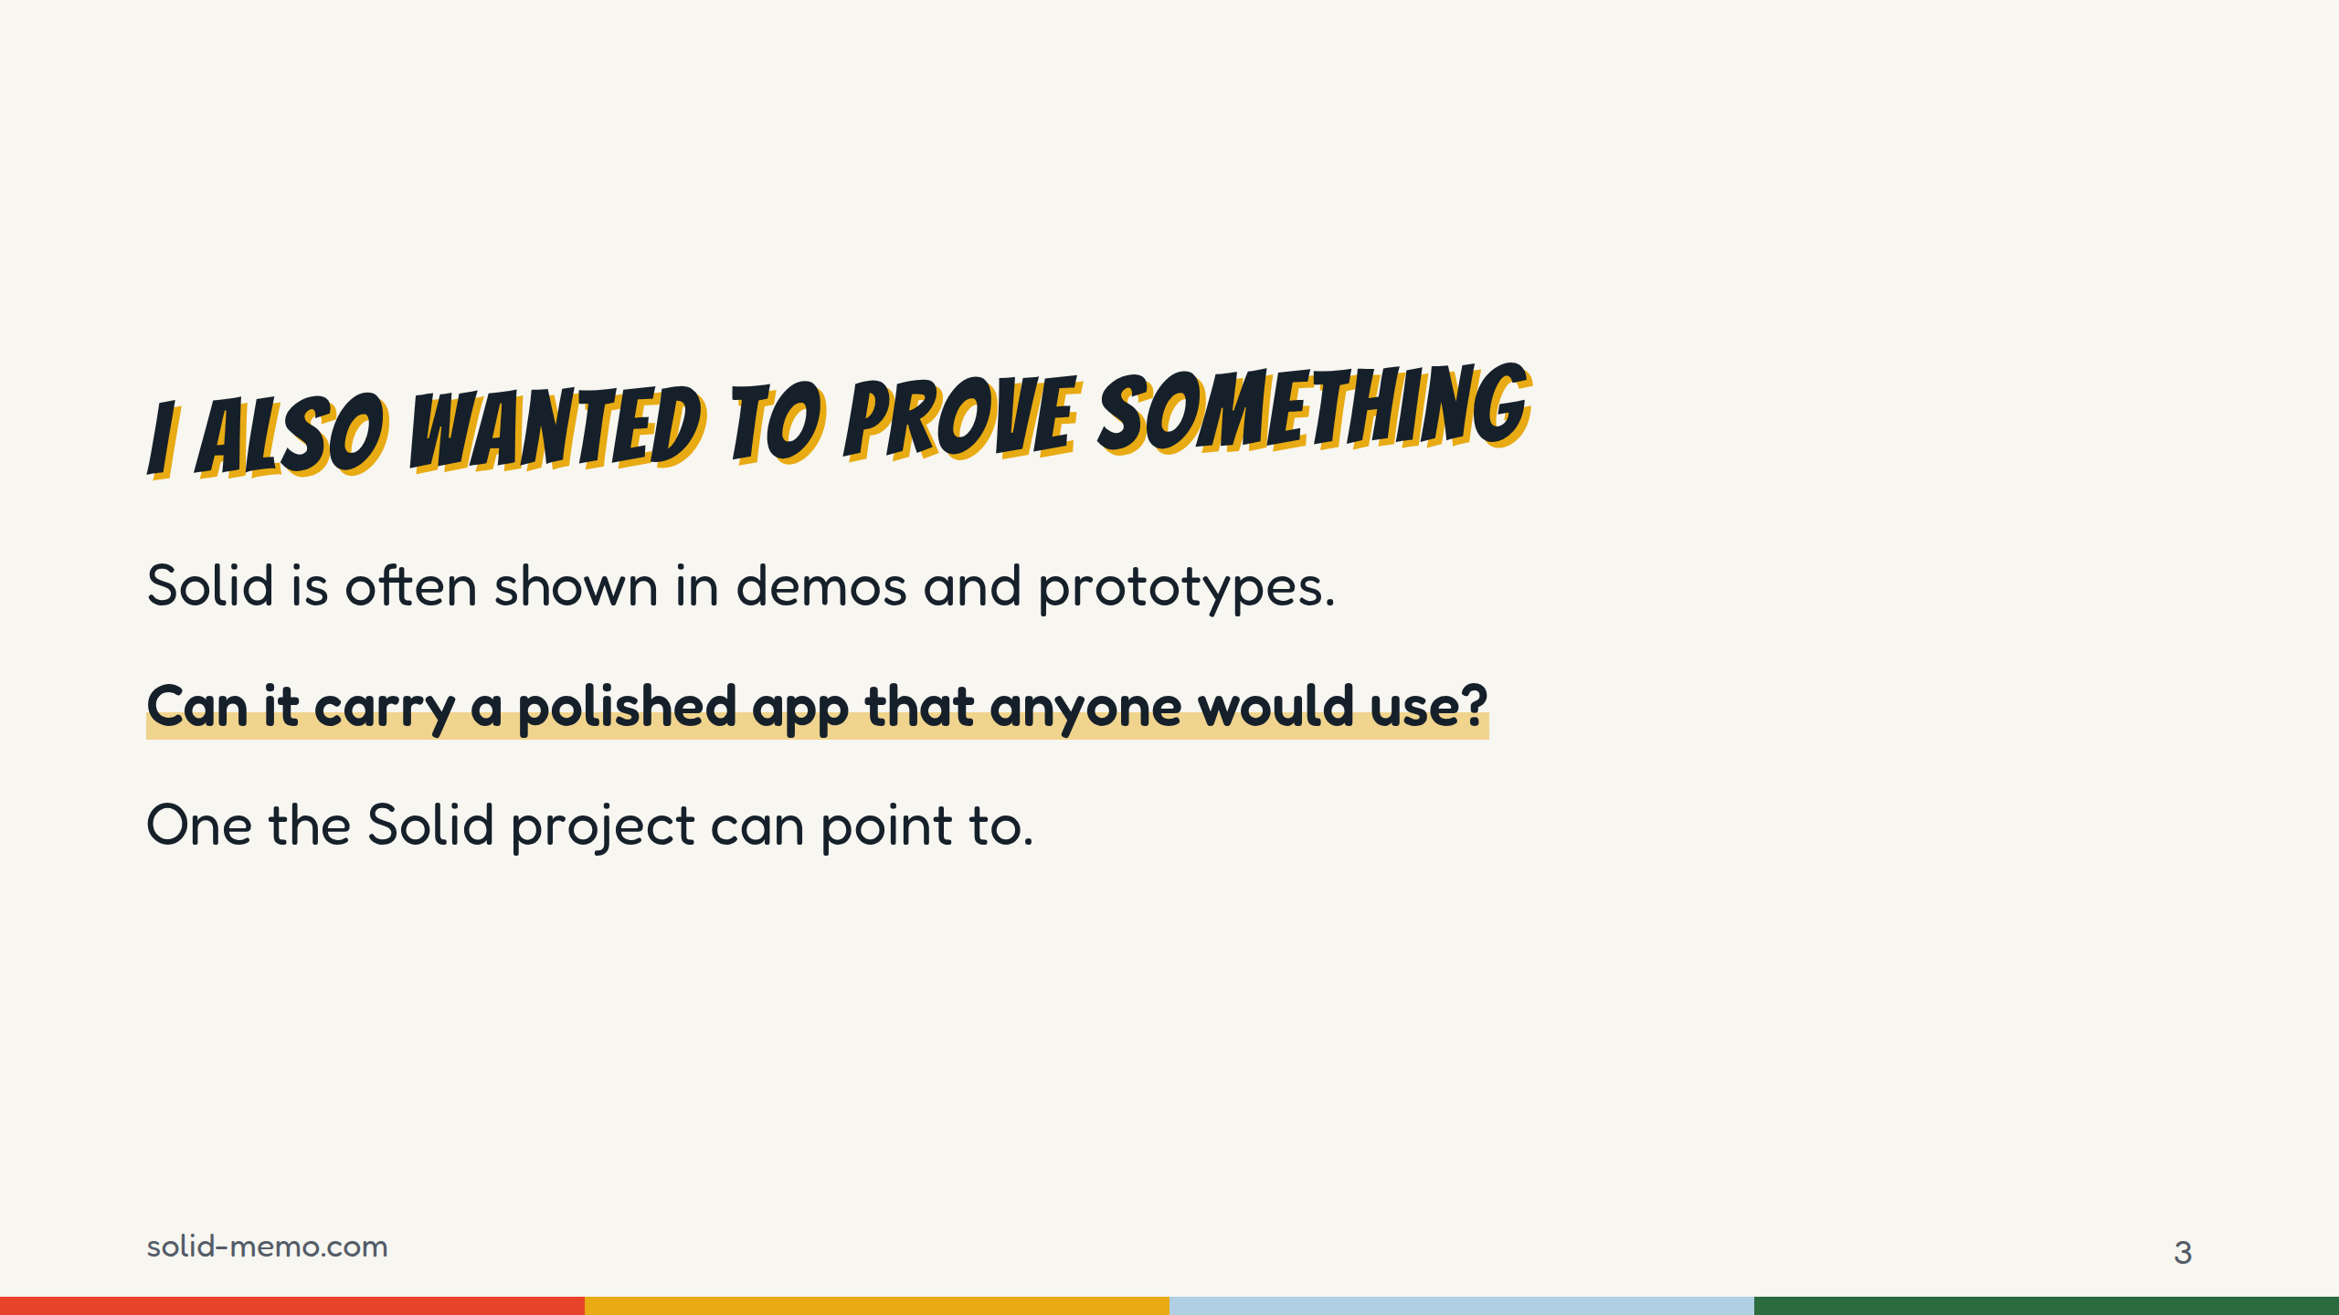
Notes:
(Your own words again.)
The second reason. Solid has been around for years, and it's usually shown as a demo or a research prototype. I wanted to build something polished enough that the Solid project could point to it and say: this is what it looks like when it's done properly.
So the bar wasn't "it works". The bar was: tested, accessible, translated, documented, stable. You'll see the evidence later.

Slide 4
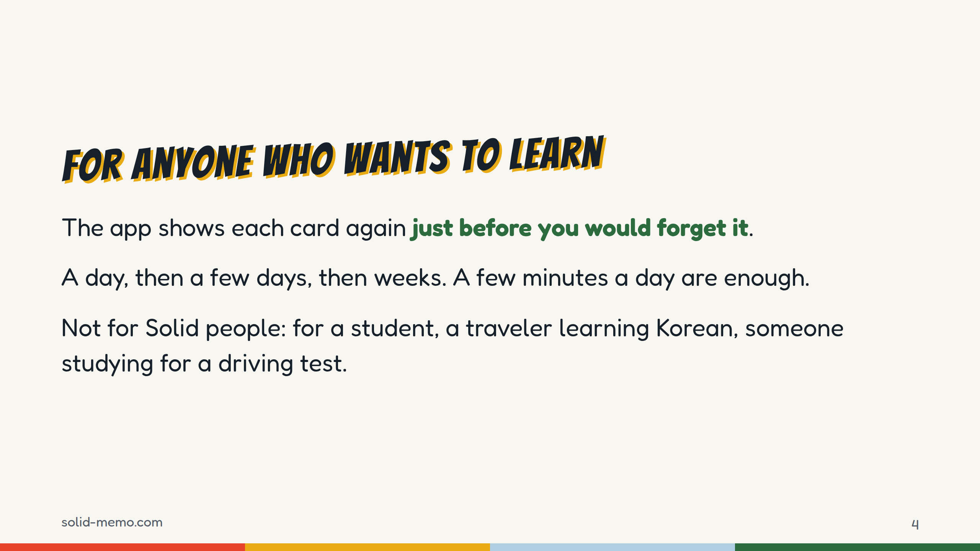
Notes:
Spaced repetition in one breath: you study flashcards, and each card comes back just before you'd forget it. The better you remember a card, the longer it waits: a day, then a few days, then weeks. A card you forgot comes back soon.
The audience matters. Solid Memo isn't a tool for Solid developers. It's for anyone who wants to remember what they learn. If Solid is going to be a showcase, it has to work for people who've never heard of it.
(The wording here is the app's own: "just before you would forget it" is from the README, "a few minutes a day" from the About page, and "a day, then a few days, then weeks" from the user guide.)

Slide 5
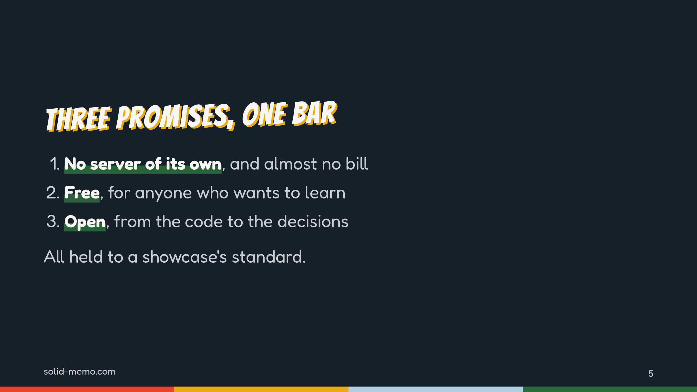
Notes:
Here's the map of the talk. Three promises.
One: no server of my own, and almost no bill. You'll see the bill: it's one line.
Two: free, for anyone who wants to learn.
Three: open, the code, the data formats and how decisions are made.
And all three are held to a showcase standard. That's the fourth part: the proof.

Slide 6
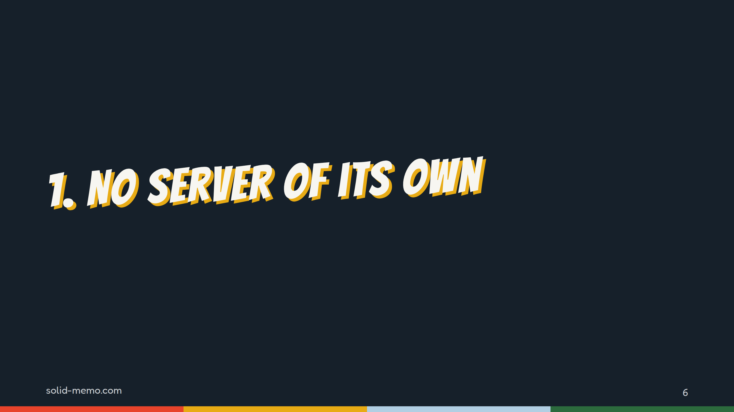
Notes:
Part one. To see how an app can have no server, you need to know what a Solid pod is. Five minutes on that.

Slide 7
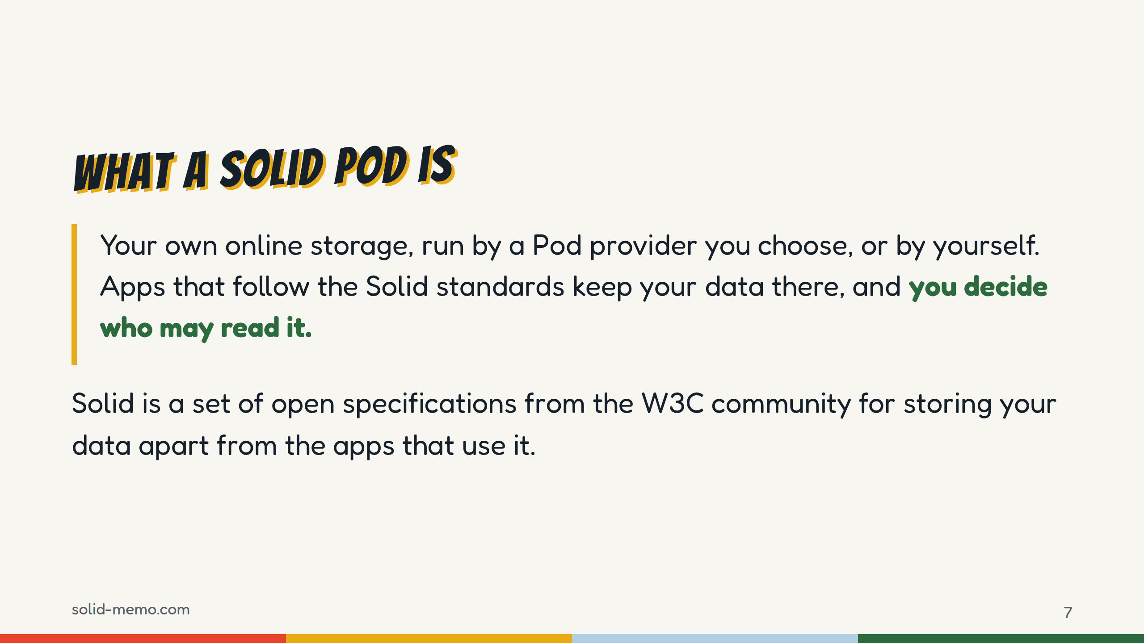
Notes:
The definition is from Solid Memo's user guide.
Think of it as a personal data folder on the web that any app following the Solid standards can use, with your permission. You pick where it lives: a provider such as solidcommunity.net, solidweb.me or Inrupt's PodSpaces, or your own server. (If someone asks which to pick: Inrupt says PodSpaces is a developer preview, not for personal data.)
Solid is the set of specifications, started by Tim Berners-Lee. You don't need to know them to follow this talk; the next slide shows what matters.

Slide 8
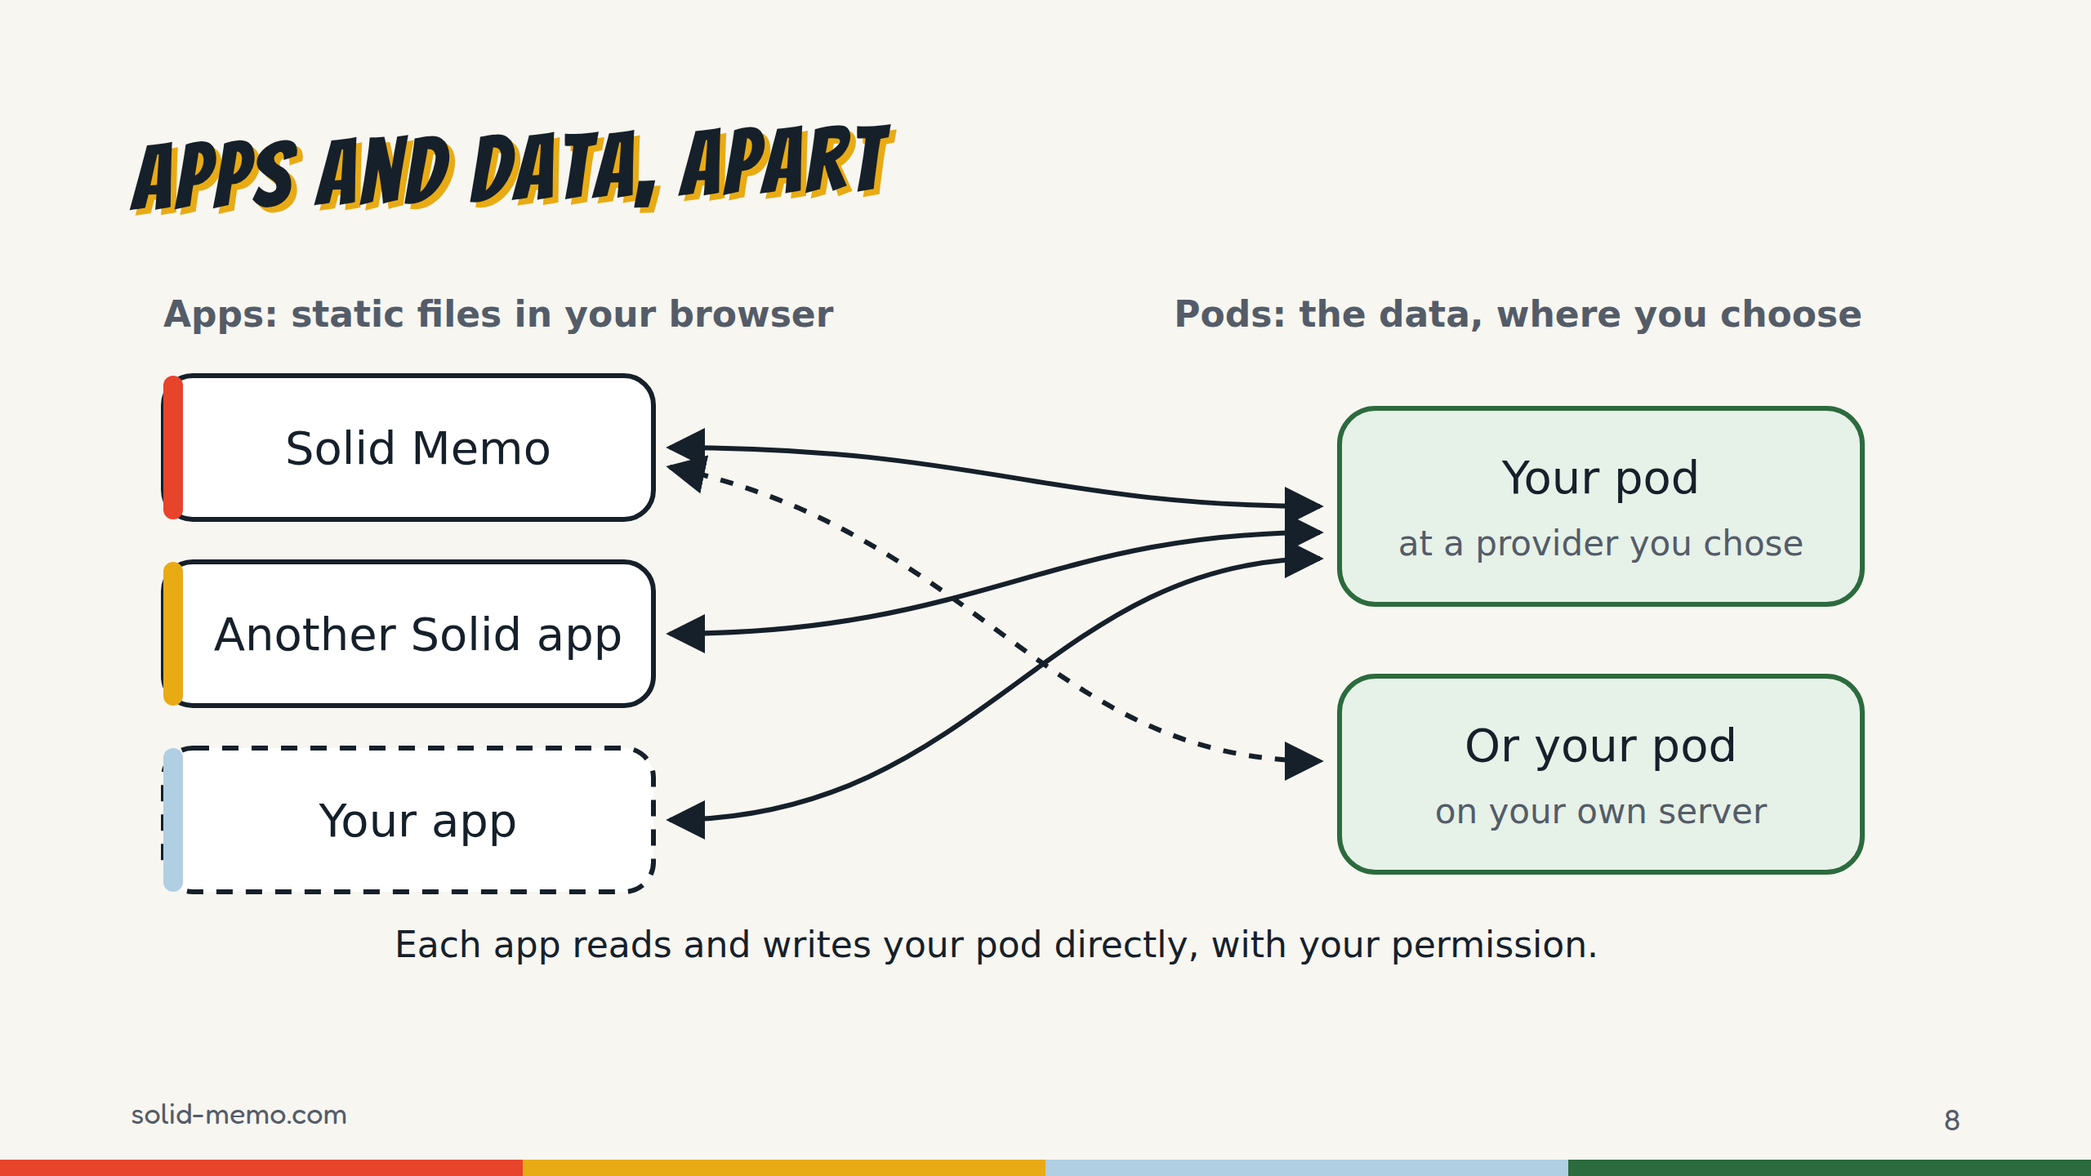
Notes:
The key idea. On the left, apps. On the right, pods. The app is just a web page. It doesn't store your data: it reads and writes your pod directly from your browser.
Logging in: you type your WebID, a web address that names you, and the app reads your profile, finds your identity provider and sends you there; or you press the button of a suggested provider, and it sends you straight there. Either way you log in with Solid-OIDC, which is OpenID Connect plus DPoP, which ties each token to a key in your browser. You type your password on your provider's own page. Solid Memo never sees it, and there's no sign-up form.
Because the data isn't in the app, another app can read the same pod. And when you stop using the app, your history stays where it is.

Slide 9
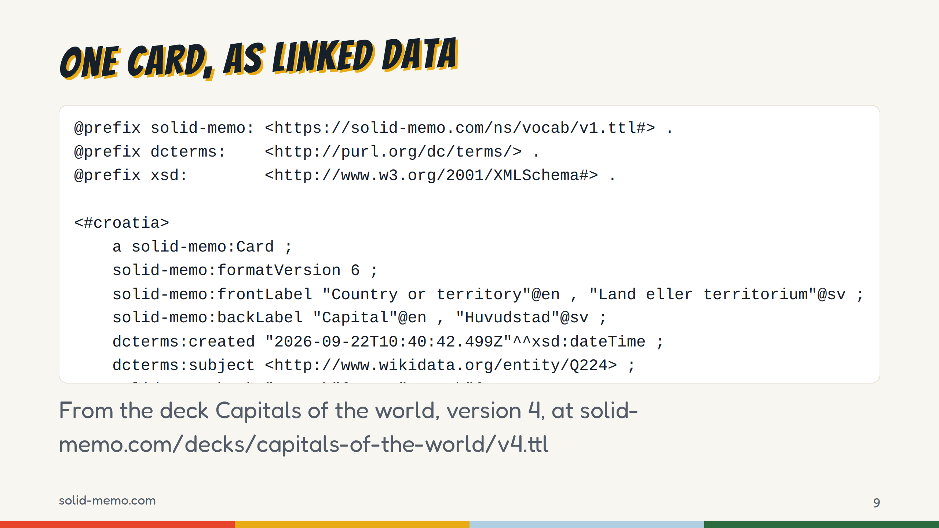
Notes:
This is a real card, from the deck Capitals of the world, version 4. Shortened: the card has every text in six languages, English, Swedish, Korean, German, Spanish and French, and the slide shows two of them per line; it names two Wikidata subjects, and the slide shows Croatia's; only the prefixes this card uses are kept.
The format is Turtle, a plain-text way to write RDF, the W3C's model for linked data, where every statement is a subject, a property and a value.
Three things to notice. First, it's text you can read. Second, every word with a colon is a web address: solid-memo:Card is defined at solid-memo.com/ns/vocab. Third, every value has a language tag, so one card holds every language. And dcterms:subject points at Wikidata's Croatia: the card says what it's about with an address the whole web shares.
This isn't a row in my database. It's a document on the web, and any RDF tool can read it. The vocabulary and the SHACL shapes that describe valid data are published too.

Slide 10
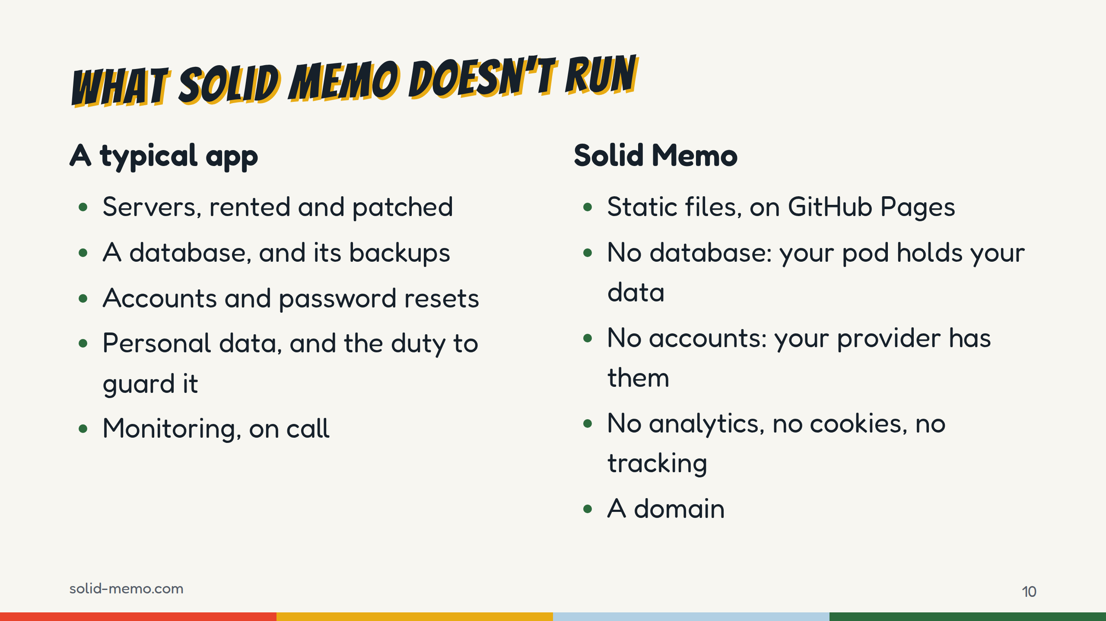
Notes:
The two columns side by side.
Solid Memo builds to plain static files with no server-side code. It's hosted on GitHub Pages and deployed by CI, one released version at a time.
The privacy page says it in one sentence: Solid Memo has no server of its own and no accounts. The app has no analytics, sets no cookies and does not track you.
To be precise, because someone will ask: your browser does talk to servers. GitHub Pages serves the app, your pod and your login provider are servers, and pictures on cards come from hosts such as Wikimedia. They just aren't mine, and none of them gets a copy of your study.

Slide 11
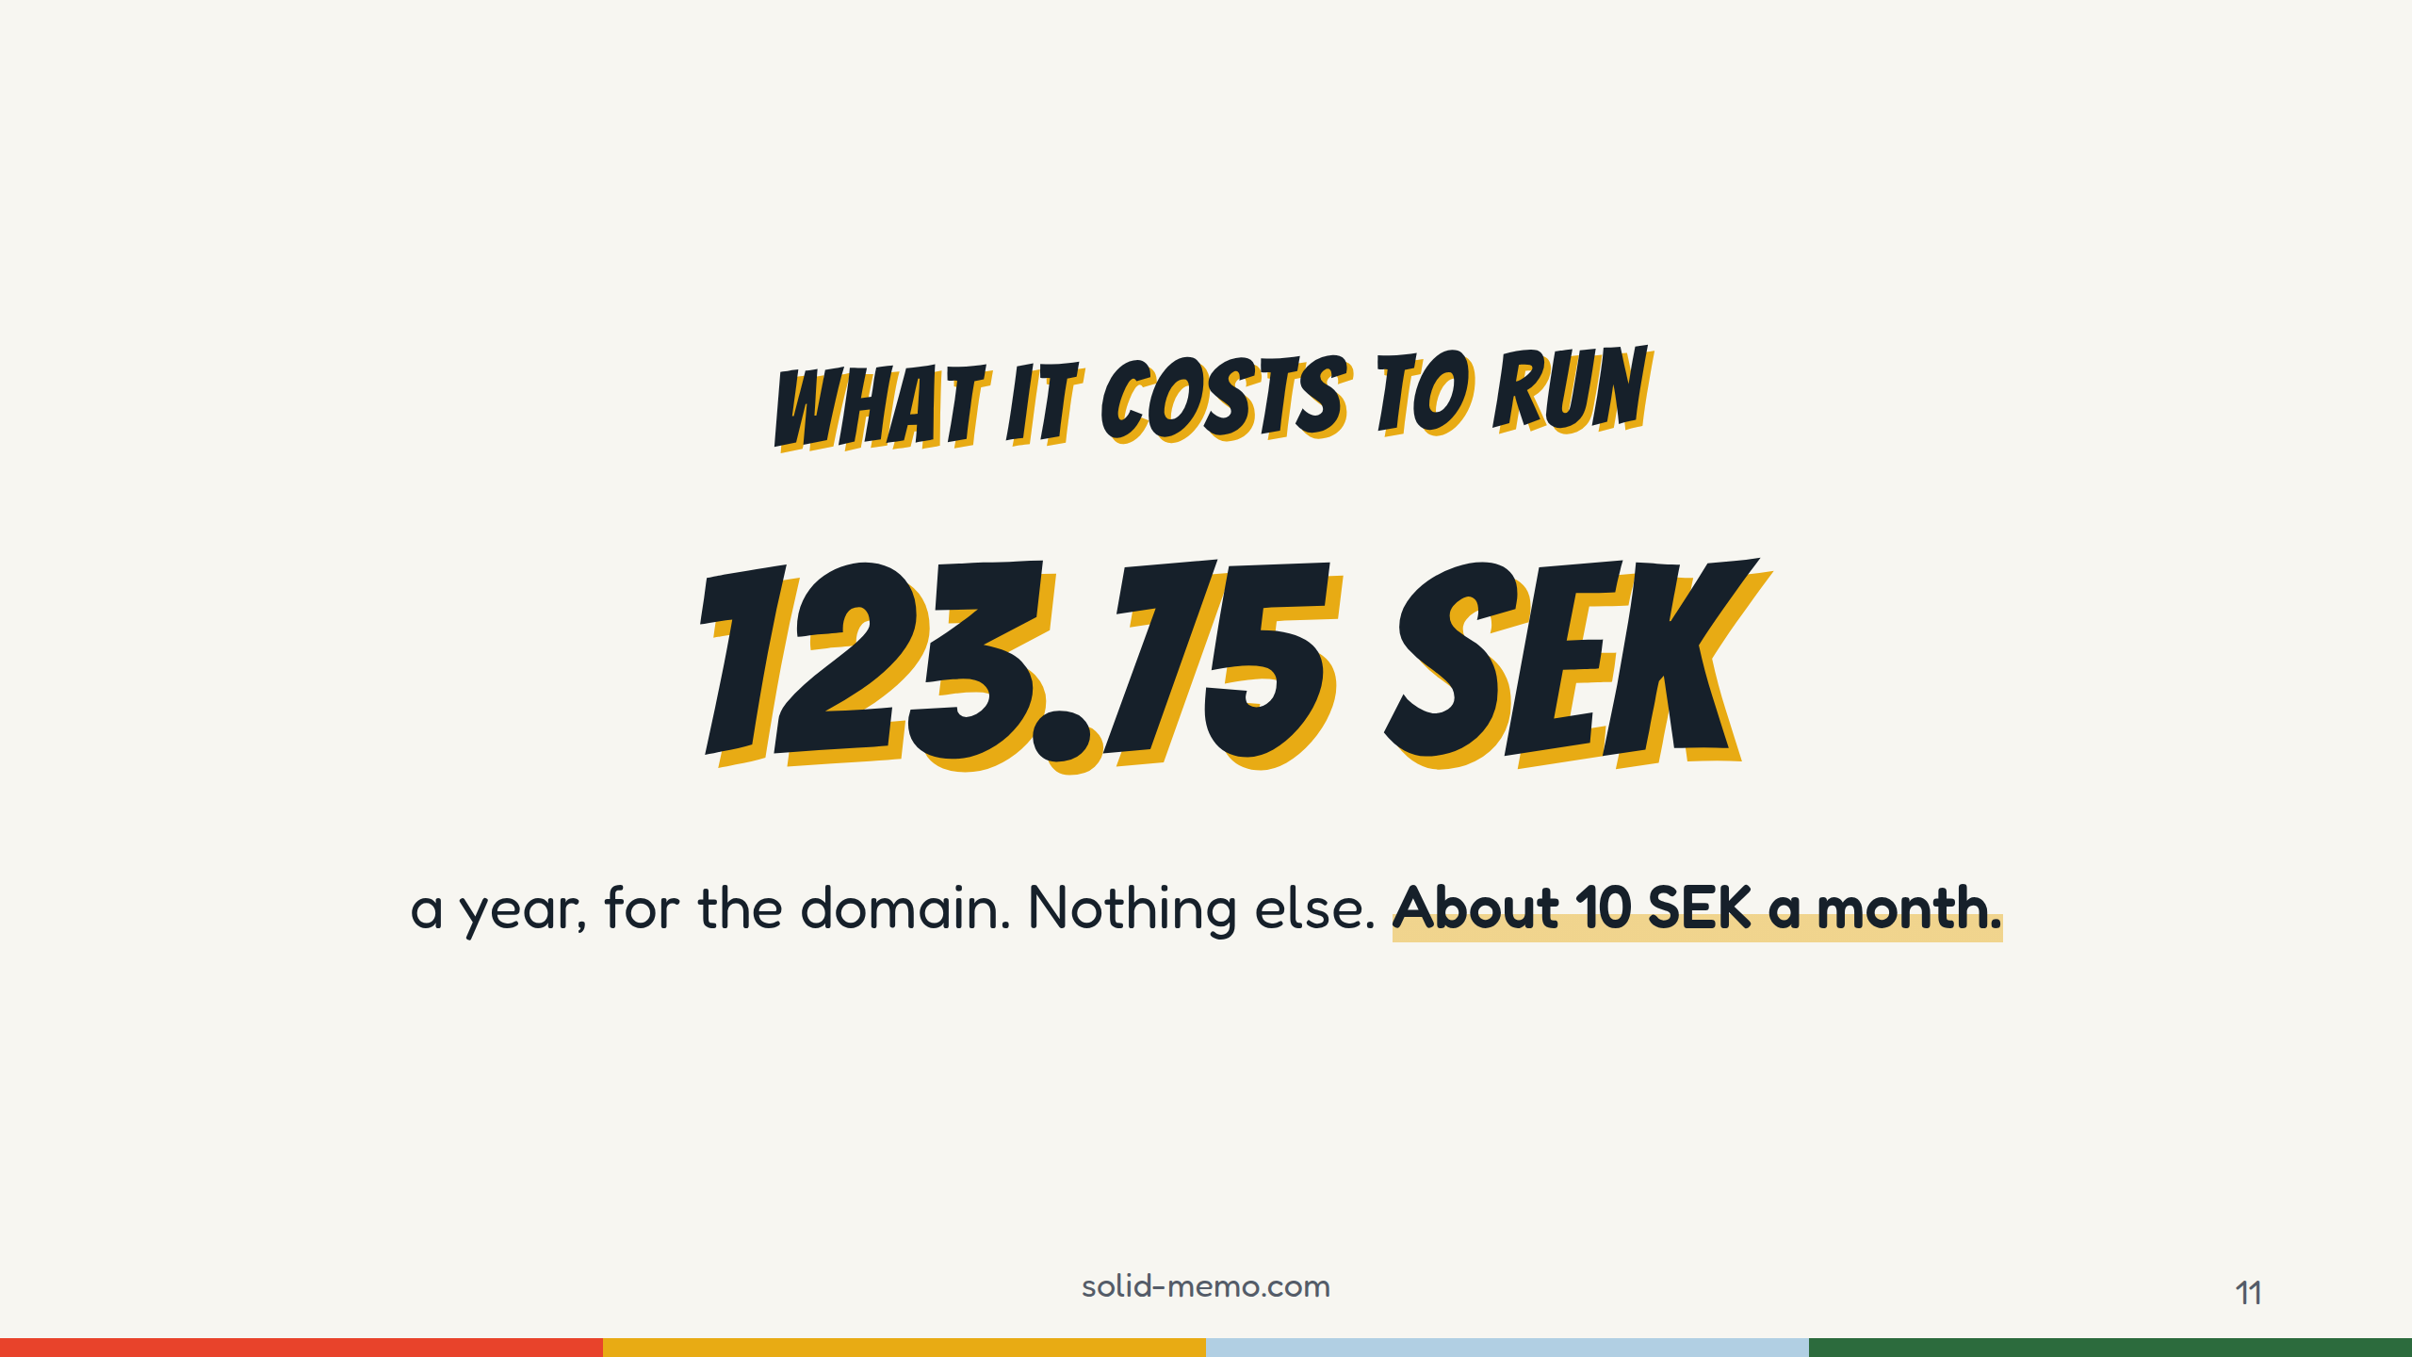
Notes:
This is the whole bill: 123.75 Swedish kronor a year, for solid-memo.com. That's about 10 kronor a month, roughly €11 a year (check the exchange rate before you say it).
Everything else costs nothing because the repository is public: the code on GitHub, CI on GitHub Actions, hosting on GitHub Pages, the archive at Zenodo and Software Heritage.
I pay the domain myself, so the project isn't self-sufficient yet. I'll come back to that at the end.

Slide 12
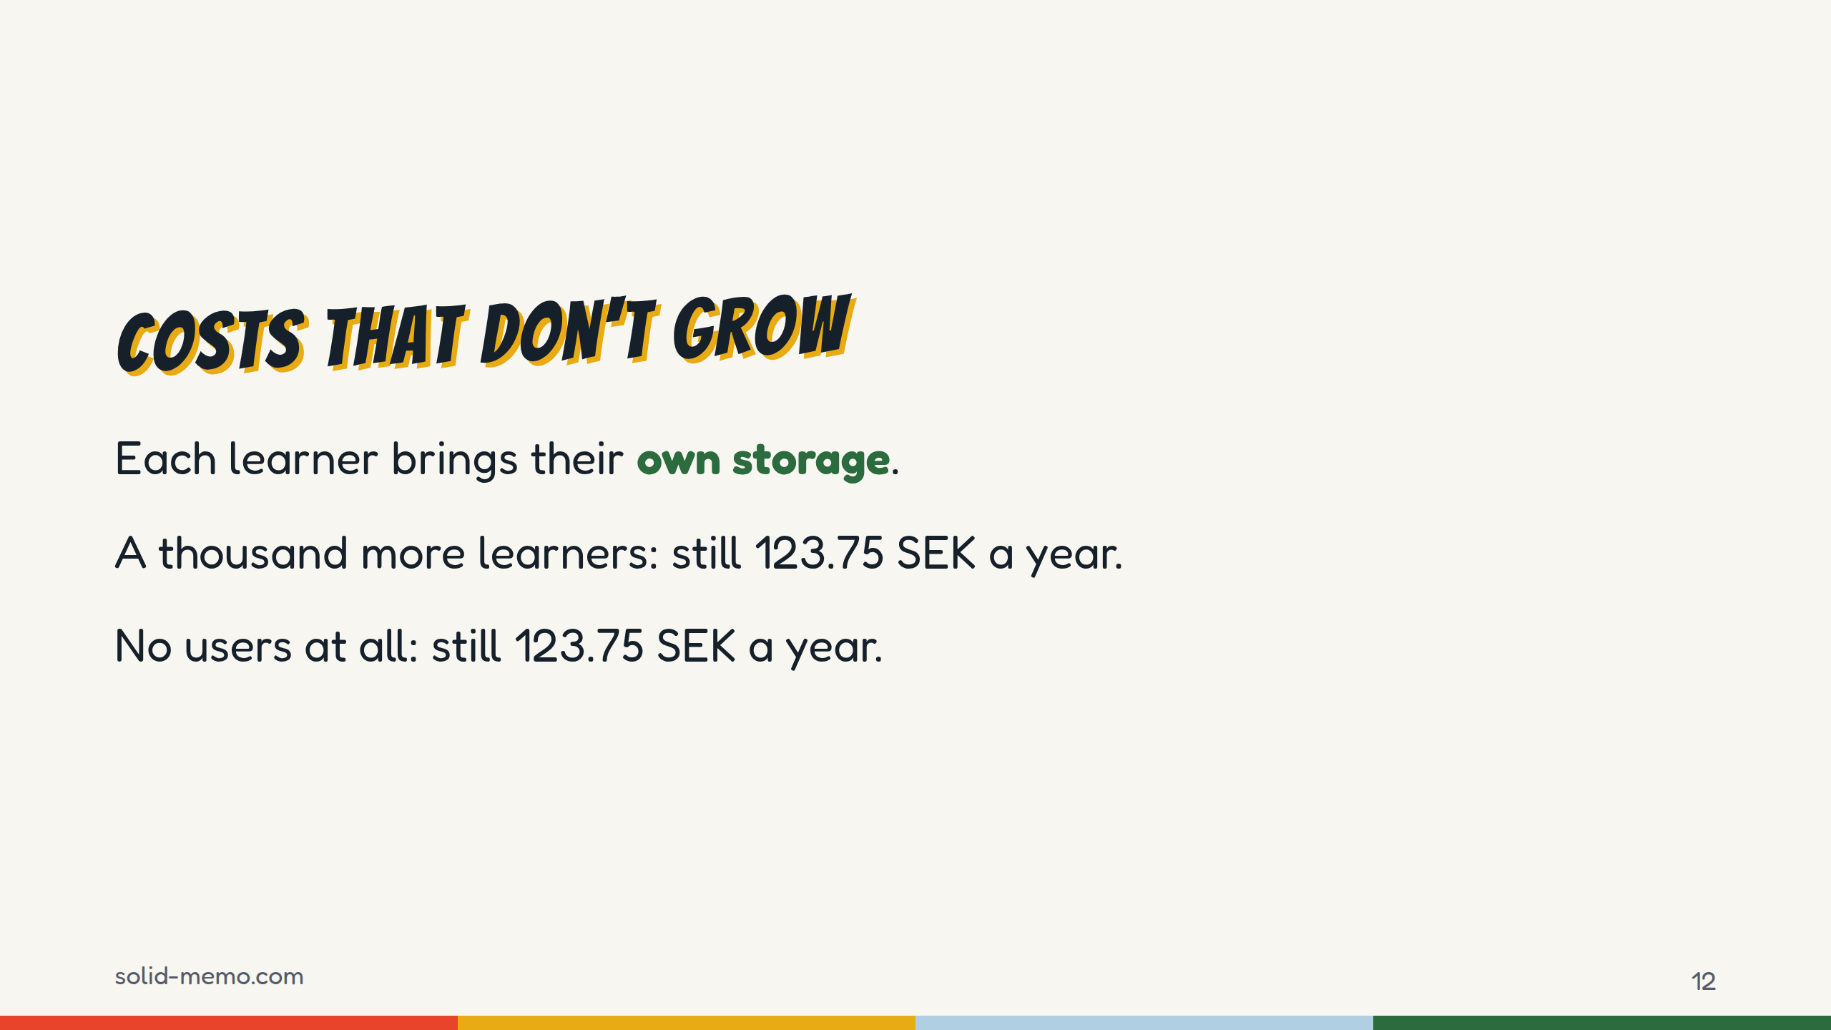
Notes:
This is the part I find most interesting as a developer.
In a normal app, cost grows with users: more storage, more database, more backups. Here, each learner brings their own storage, their pod. The app is the same static files whether ten people use it or ten thousand.
And the other way around: if nobody uses it for a year, it costs the same. There's nothing to keep running, nothing to shut down, and no data left behind to look after.

Slide 13
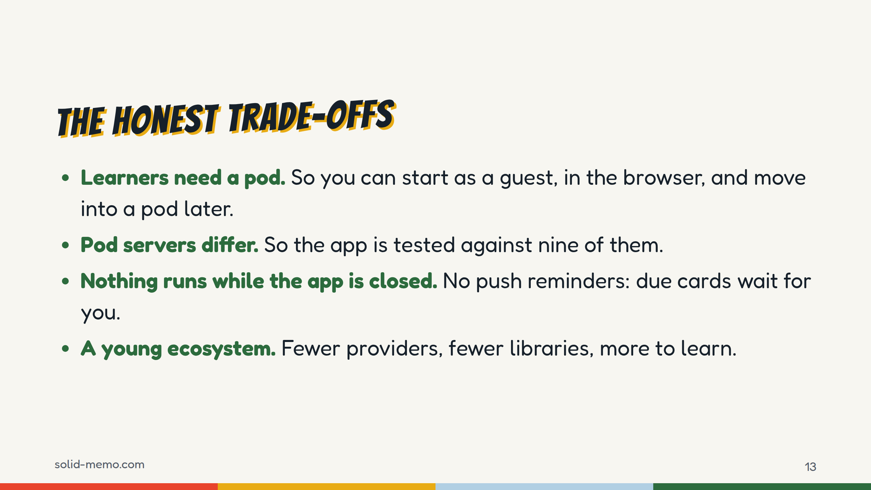
Notes:
It isn't free of trade-offs, and you should hear them from me.
A learner needs a pod. That's the biggest hurdle, so the app has a guest mode, which I'll show in a moment.
Solid is a standard, but servers implement it differently. One gives no ETags, another builds them from whole seconds. So the tests ask each server rather than assume.
With no server of its own, nothing can nudge you while the app is closed: no push notifications, no email reminders.
And the ecosystem is young. You'll write more yourself than you would with a typical stack.

Slide 14
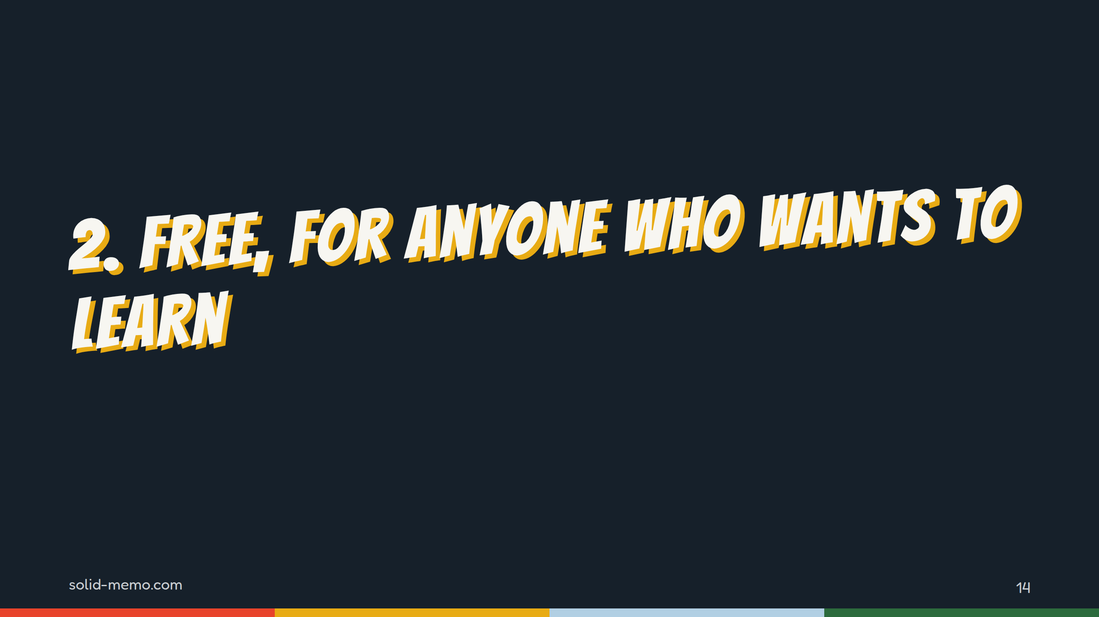
Notes:
Part two: what the app is like for a learner. Screenshots, from phones, since that's where most people study.

Slide 15
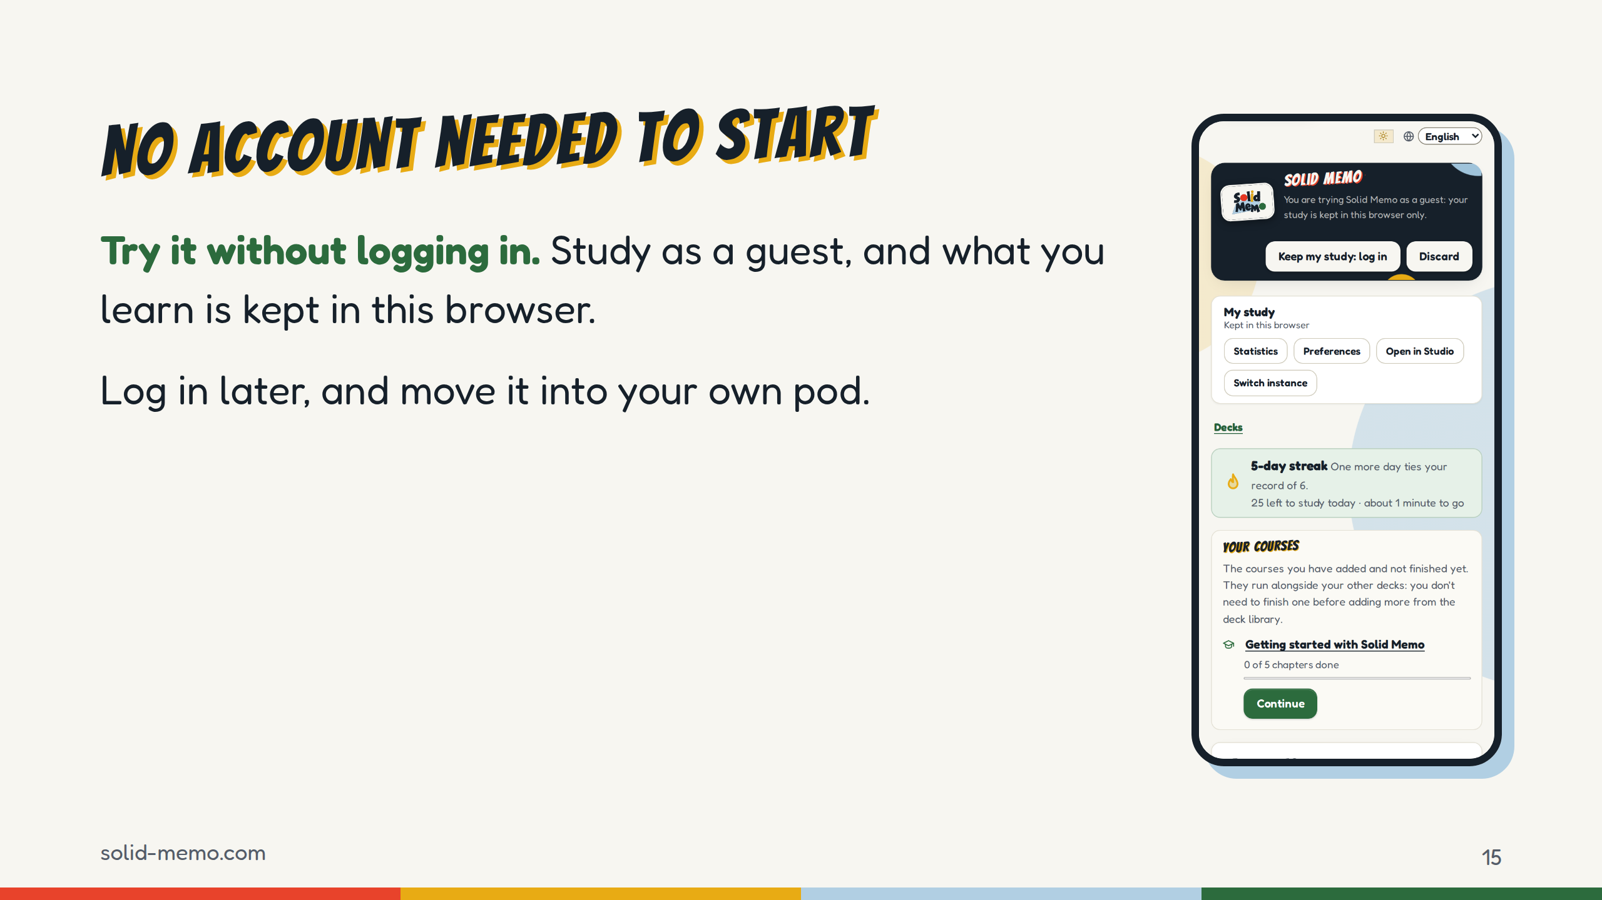
Notes:
The first screen a newcomer sees has a button: Try it without logging in. No account, no pod, nothing to sign.
Under the hood, the guest gets a small Solid pod emulated in the browser, in IndexedDB. The app talks to it exactly as it talks to a real pod server, so the deck library, studying, statistics and preferences all work the same for guests. Only publishing a deck from the Studio needs a real pod.
When you log in, the app offers to move what you studied into your own pod.
You can try it now, on your phone: solid-memo.com.

Slide 16
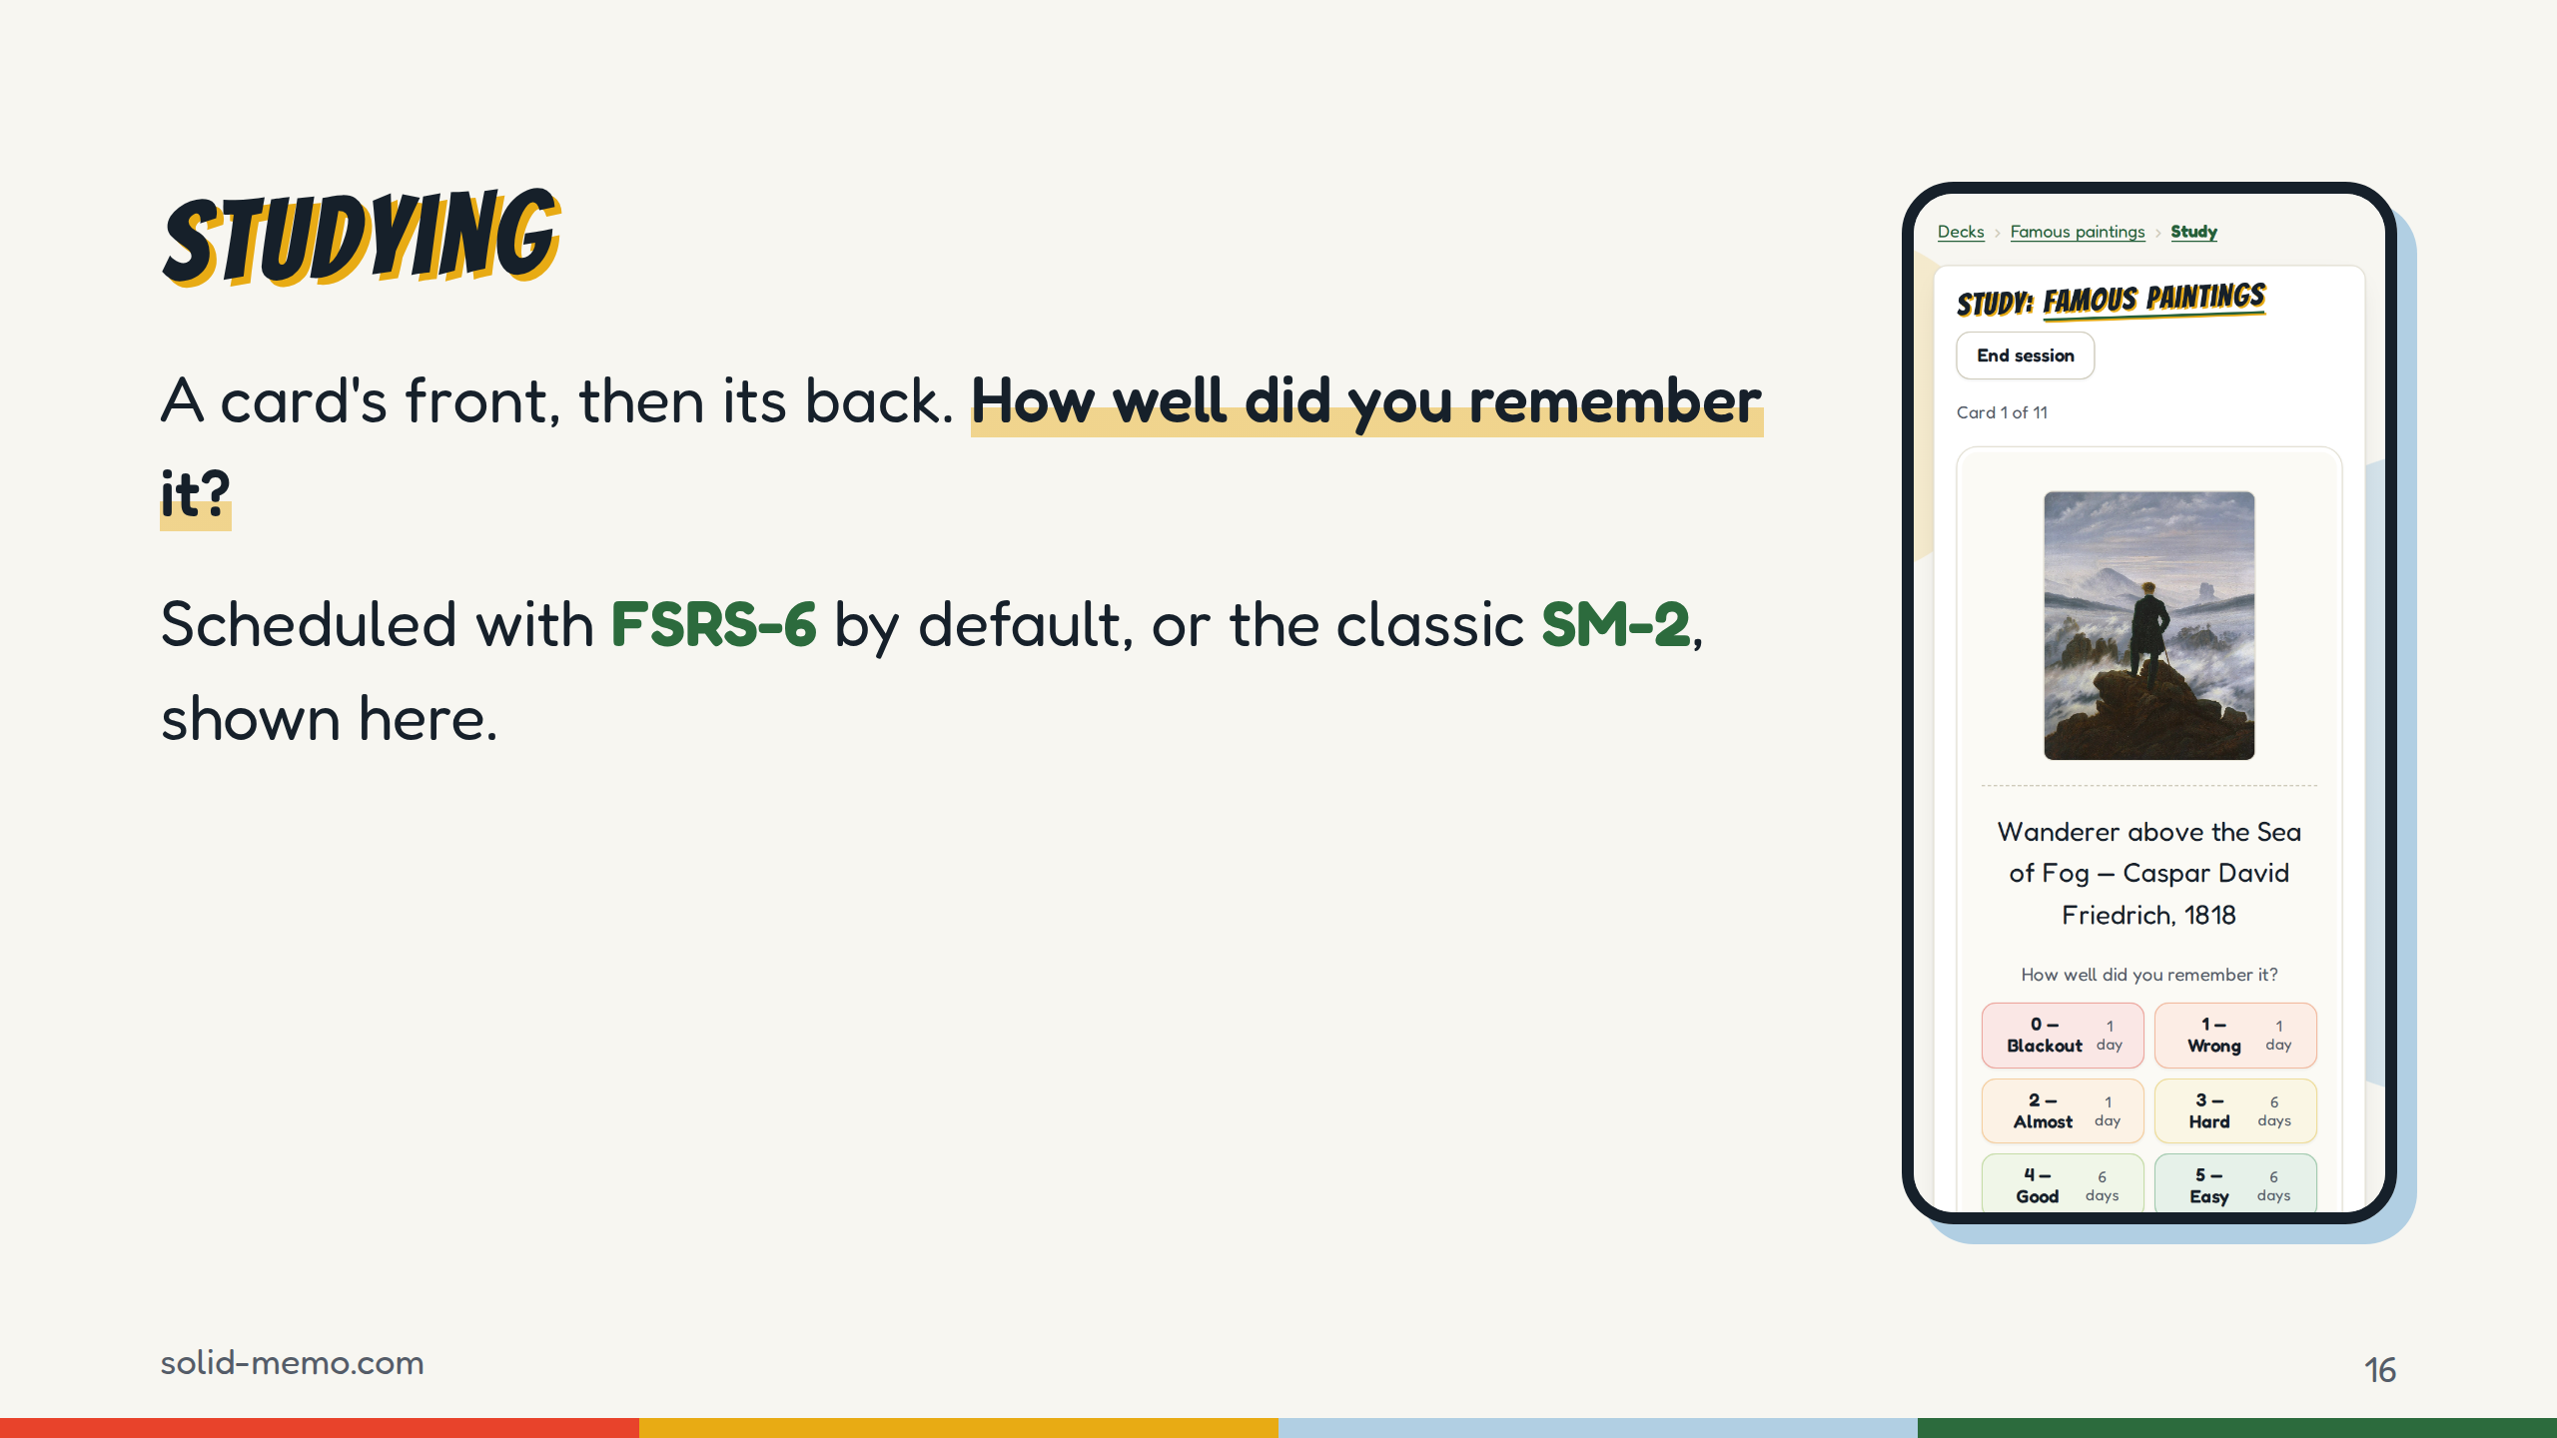
Notes:
In a session you see the front, recall the answer, turn the card, and grade yourself.
Two schedulers. FSRS-6, the Free Spaced Repetition Scheduler, by Jarrett Ye and the Open Spaced Repetition project, is the default. It picks the day your chance of remembering drops to 90%, and you can tune that. SM-2 is the classic algorithm from SuperMemo, 1990. You can switch in the preferences, and FSRS replays your past answers, so you don't start from zero.
This screenshot shows SM-2's scale, 0 to 5. Under FSRS-6, the default, you get four buttons: Again, Hard, Good, Easy.
Even that choice is linked data in your pod, not a setting on a server.

Slide 17
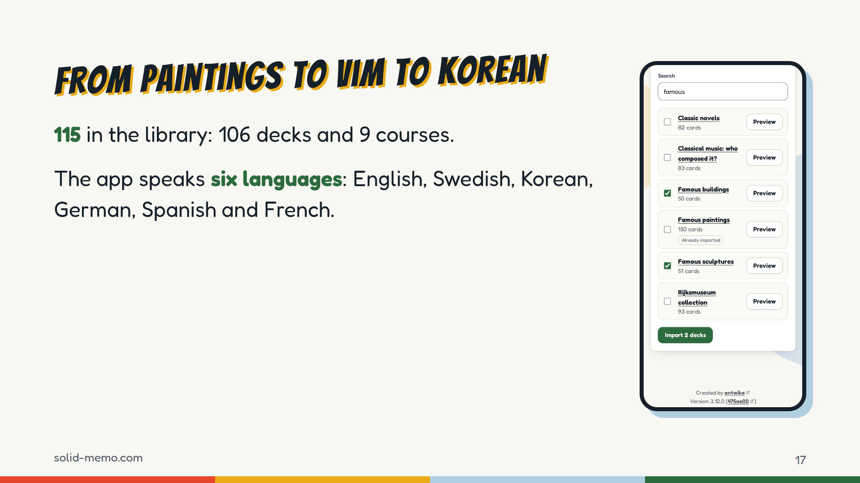
Notes:
The library, as of November 4, 2026: 115 entries, 106 flashcard decks and 9 courses, about 19,000 cards in their newest versions. Check the number again before you give the talk; it grows.
The range is the point. HTTP status codes and Vim commands. The brightest stars and the periodic table. Famous paintings and the Rijksmuseum collection. Everyday Korean phrases, chess openings, regions of the brain, Eurovision winners.
The app is in six languages (check again before the talk), and every library deck's newest version has its title and description in all six. Arabic decks show their text right to left.
Each deck says where it comes from and under which license it can be reused. Most are CC0, CC BY-SA or CC BY.

Slide 18
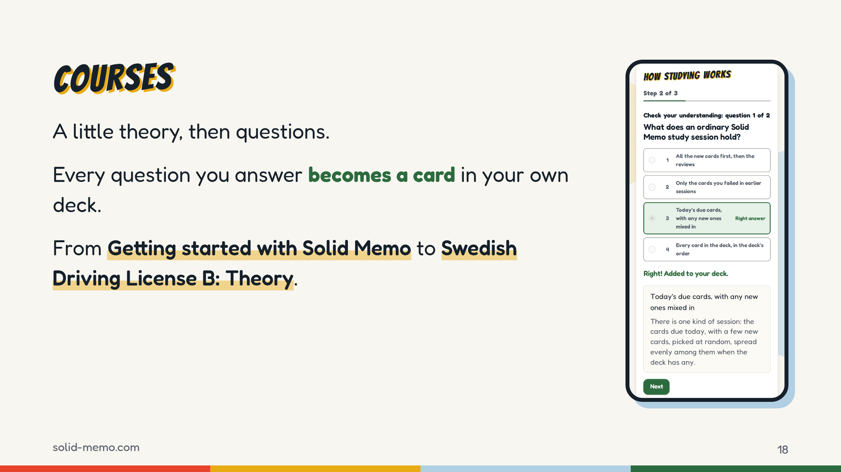
Notes:
Courses are chapters of short steps: a bit of theory, then multiple-choice questions, and a review at the end of each chapter.
The twist: every question becomes a card in your deck, so when you finish the course, you keep studying it.
The nine courses now: Getting started with Solid Memo, which every newcomer is offered; Solid fundamentals; Korean at the Table; Reading Hangul; Web accessibility with WCAG 2.2; Open licenses; DCAT and DCAT-AP; the Standard for Public Code; and Swedish Driving License B: Theory. Check the list again before the talk; it grows.
A course isn't a new kind of thing in the pod. It's a library release with an outline.

Slide 19
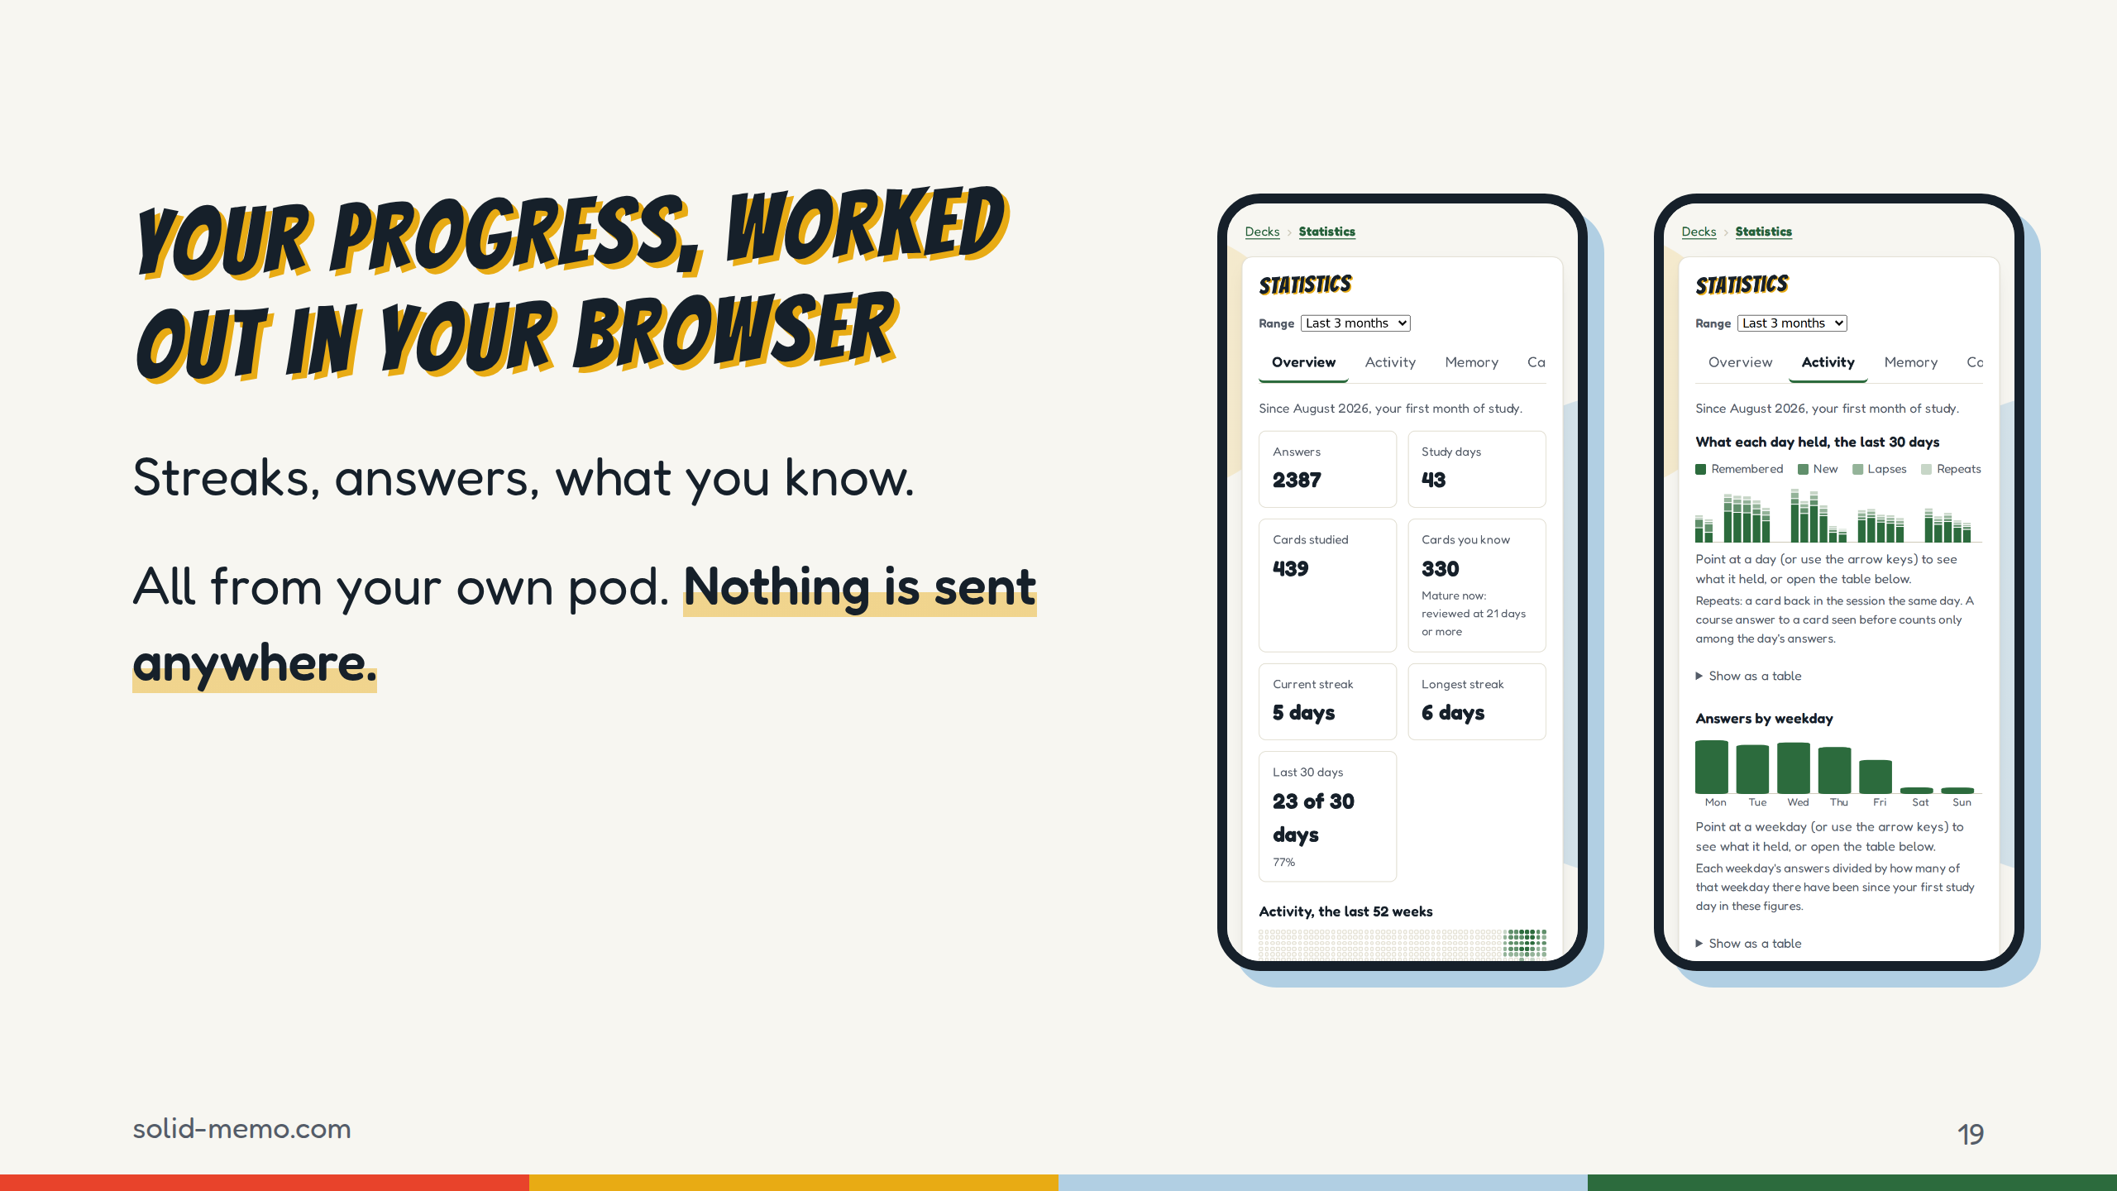
Notes:
There's a strip above the deck list with today's streak and answers, and a statistics page with an overview, activity, memory and cards.
Every figure is worked out in the browser from the answer log in your pod. There's no analytics server, because Solid Memo has no server of its own. You can also download your answers as a CSV.
That's what owning your data means in practice: the app reads your history, and so can anything else you allow.

Slide 20
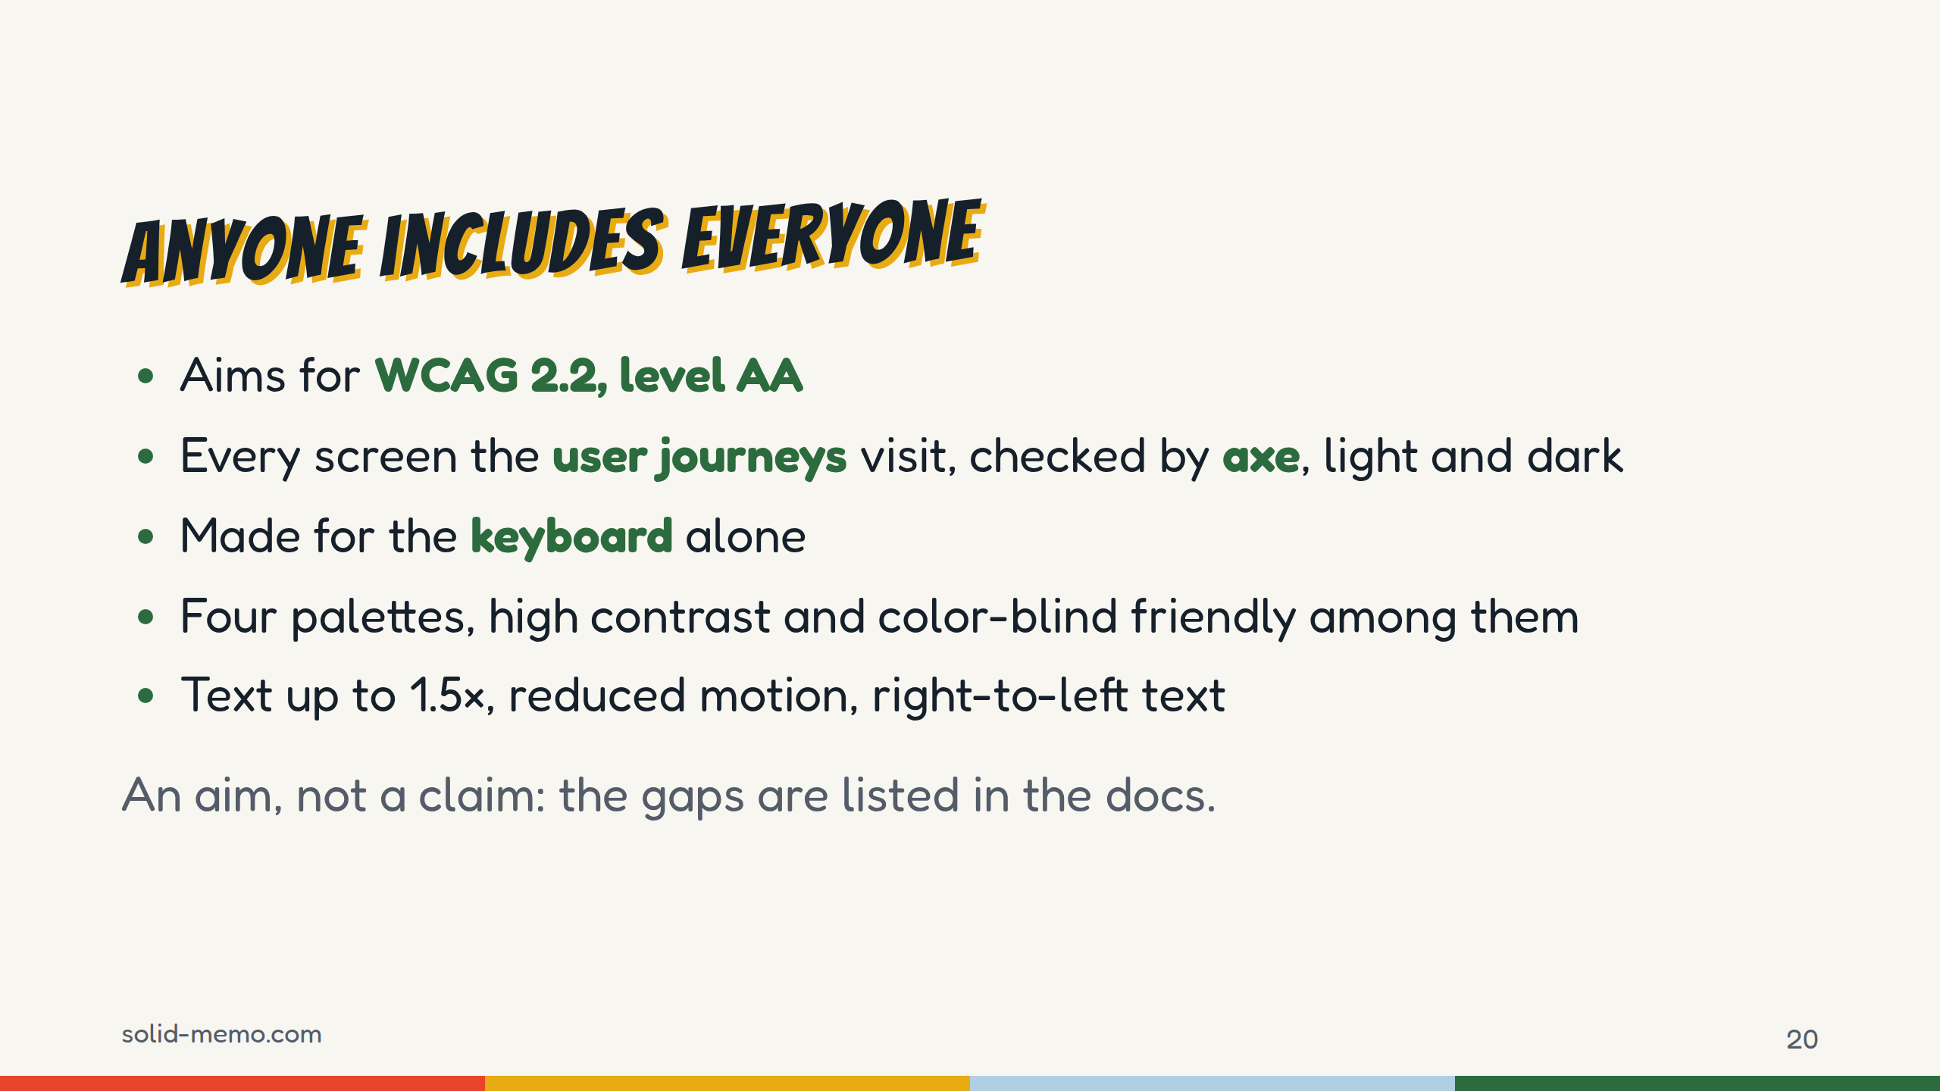
Notes:
Free for anyone means usable by anyone.
The aim is WCAG 2.2 at level AA. It's an aim, not a claim of conformance: there's been no full audit, and there's no recorded screen-reader pass yet. The docs list the gaps.
What is checked: every user journey runs axe on every screen a step ends on, in Chromium, and the guest and reload journeys again on a phone. Theme tours check every screen in dark mode too, and the contrast of the other palettes. A violation fails the build, and the list of allowed exceptions is empty.
(Check these figures again before the talk.) There are four palettes, including high contrast at 7:1 and a color-blind friendly one, four text sizes, reduced motion, and every text is marked with its language, so Arabic reads right to left.

Slide 21
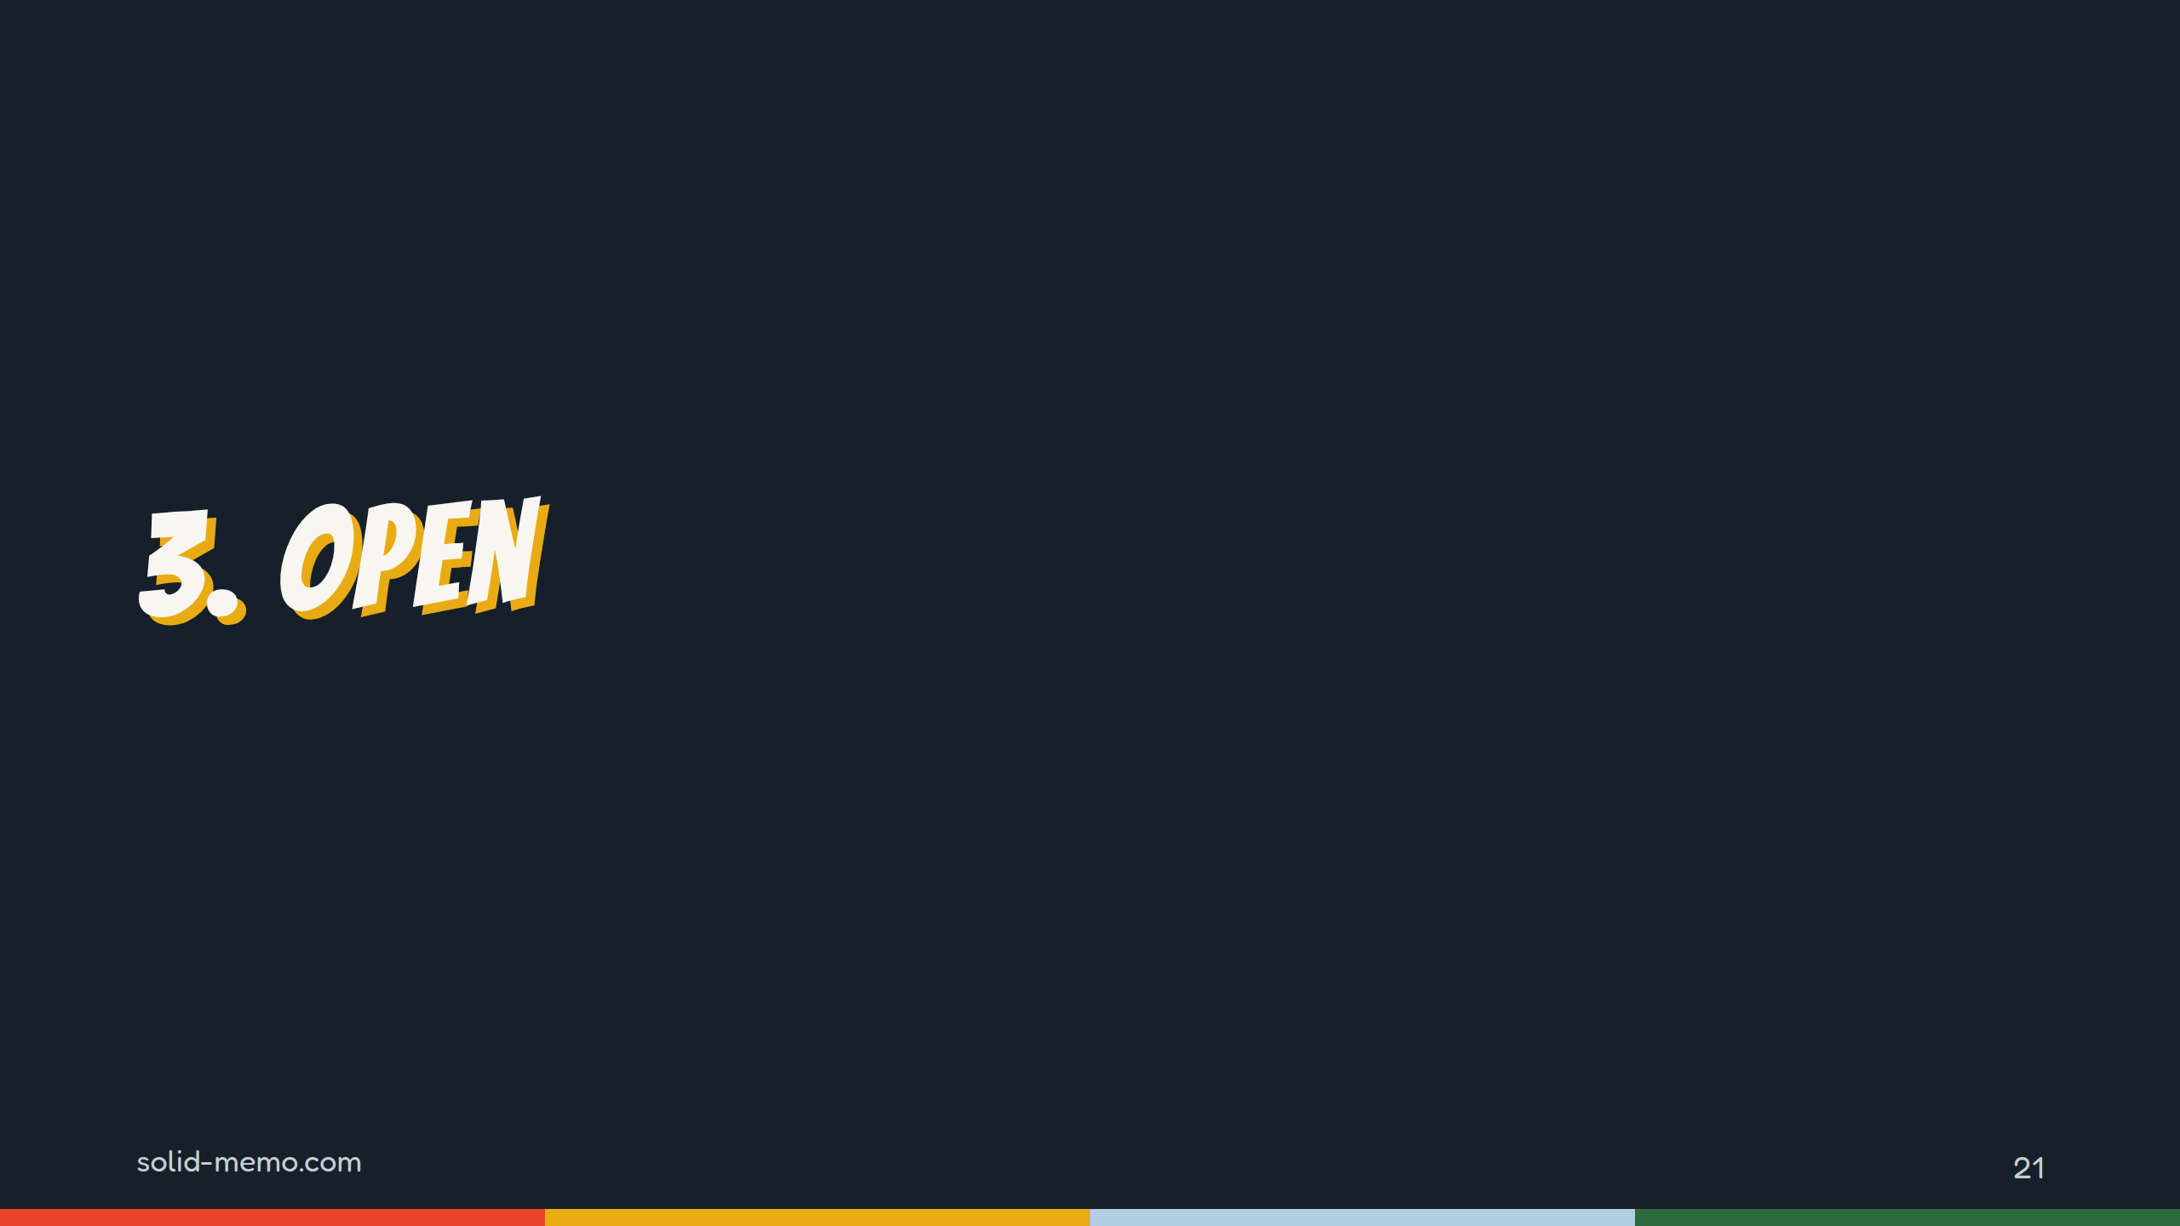
Notes:
Part three: open. Not only the code.

Slide 22
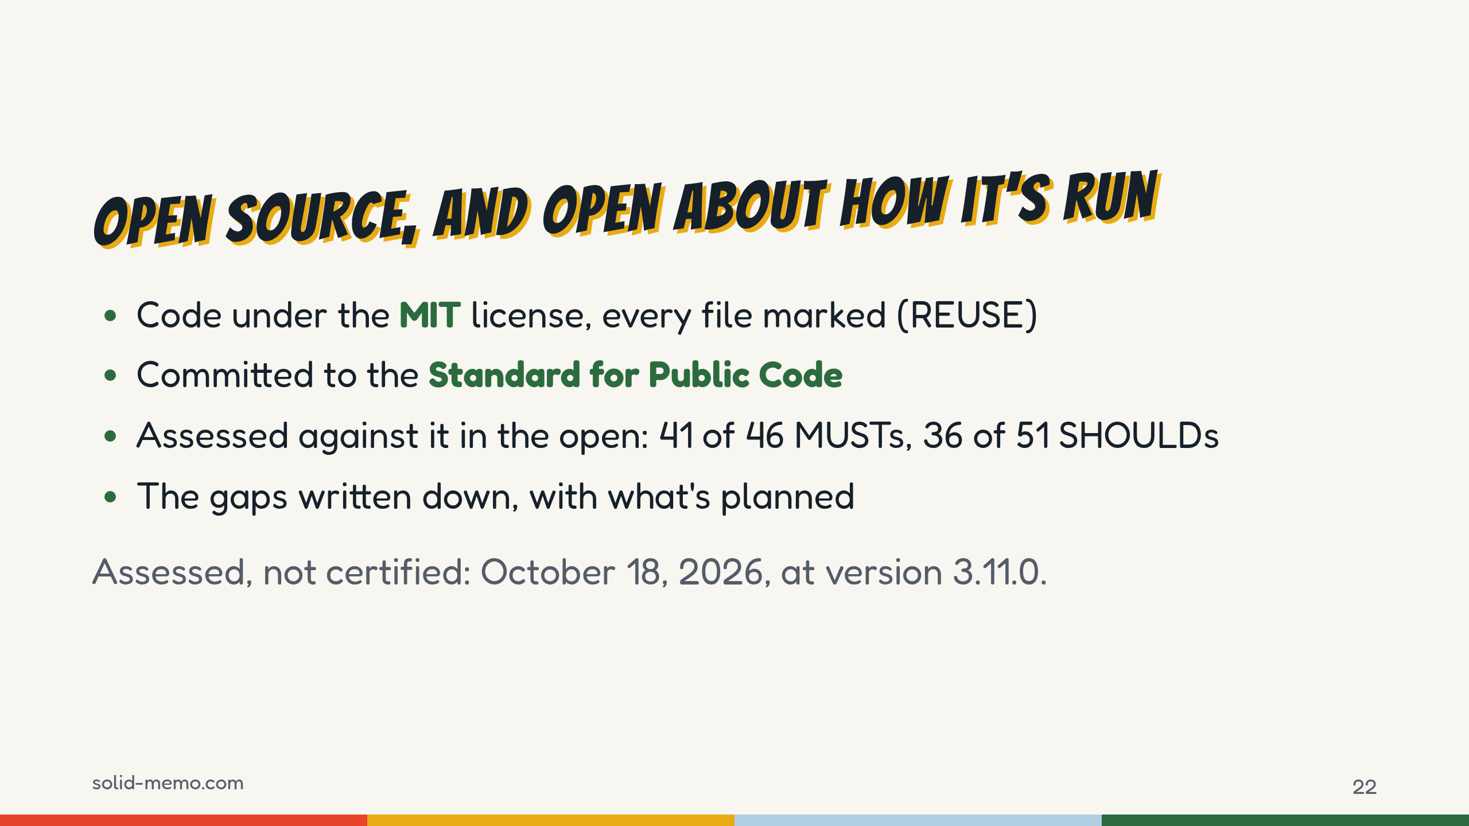
Notes:
The code is MIT, and every file says who holds the copyright and under which license, checked with the REUSE tool.
The project has committed to the Standard for Public Code, an open standard, from the Foundation for Public Code, for code that public organizations can share and reuse. Its assessment is published in the repository: 41 of 46 MUSTs and 36 of 51 SHOULDs on October 18, 2026, at version 3.11.0. Check for a newer assessment before the talk. It's my own assessment, not a certification.
The gaps are written down too. The biggest is honest and simple: with one maintainer, nobody else reviews my pull requests.

Slide 23
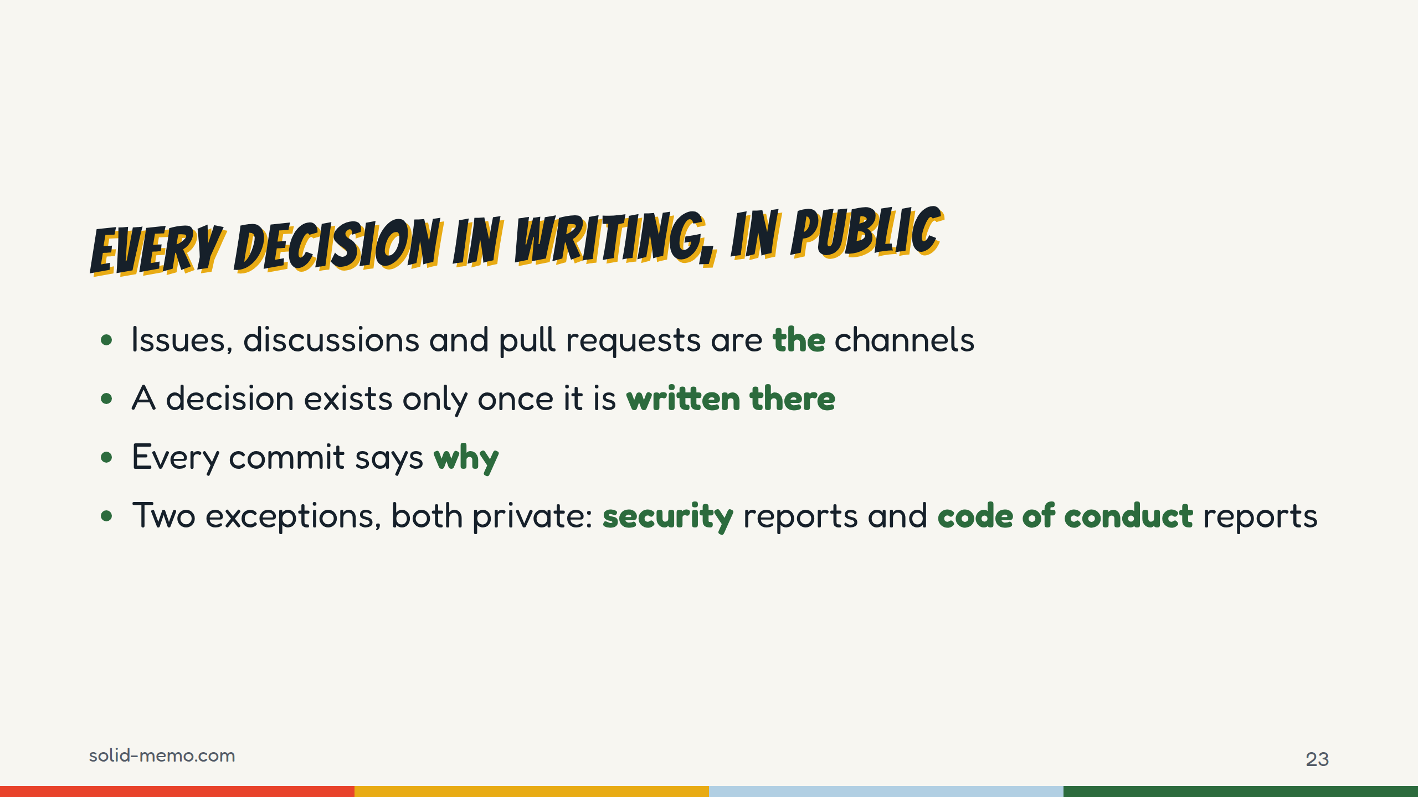
Notes:
How the project talks. Everything happens in writing, in public: issues, GitHub Discussions and pull requests. If someone messages me privately, I answer by pointing to the public channel.
A decision exists only once it's written in an issue, a discussion or a pull request, and a decision that changes the code is in the message of the commit that makes it. That's Conventional Commits with a body that says why.
There are exactly two exceptions, and both are confidential by nature: security vulnerabilities and code of conduct reports.

Slide 24
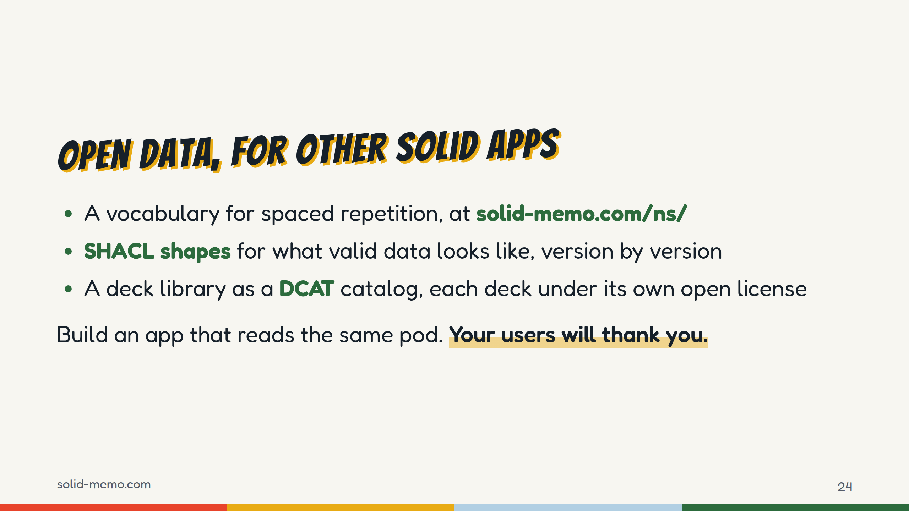
Notes:
Open source is half of it. The data has to be open too, or "you own your data" means "you own a file nobody else can read".
No existing vocabulary covered spaced repetition, so Solid Memo defines one, published at solid-memo.com/ns/vocab. SHACL shapes describe what valid data looks like, one per kind of data and per format version. The app uses them to check data and to generate code.
The deck library is a DCAT catalog, the W3C's vocabulary for data catalogs, and each deck states its license.
If you build a Solid app, you can read the same pods: a learner's cards, schedule and history.

Slide 25
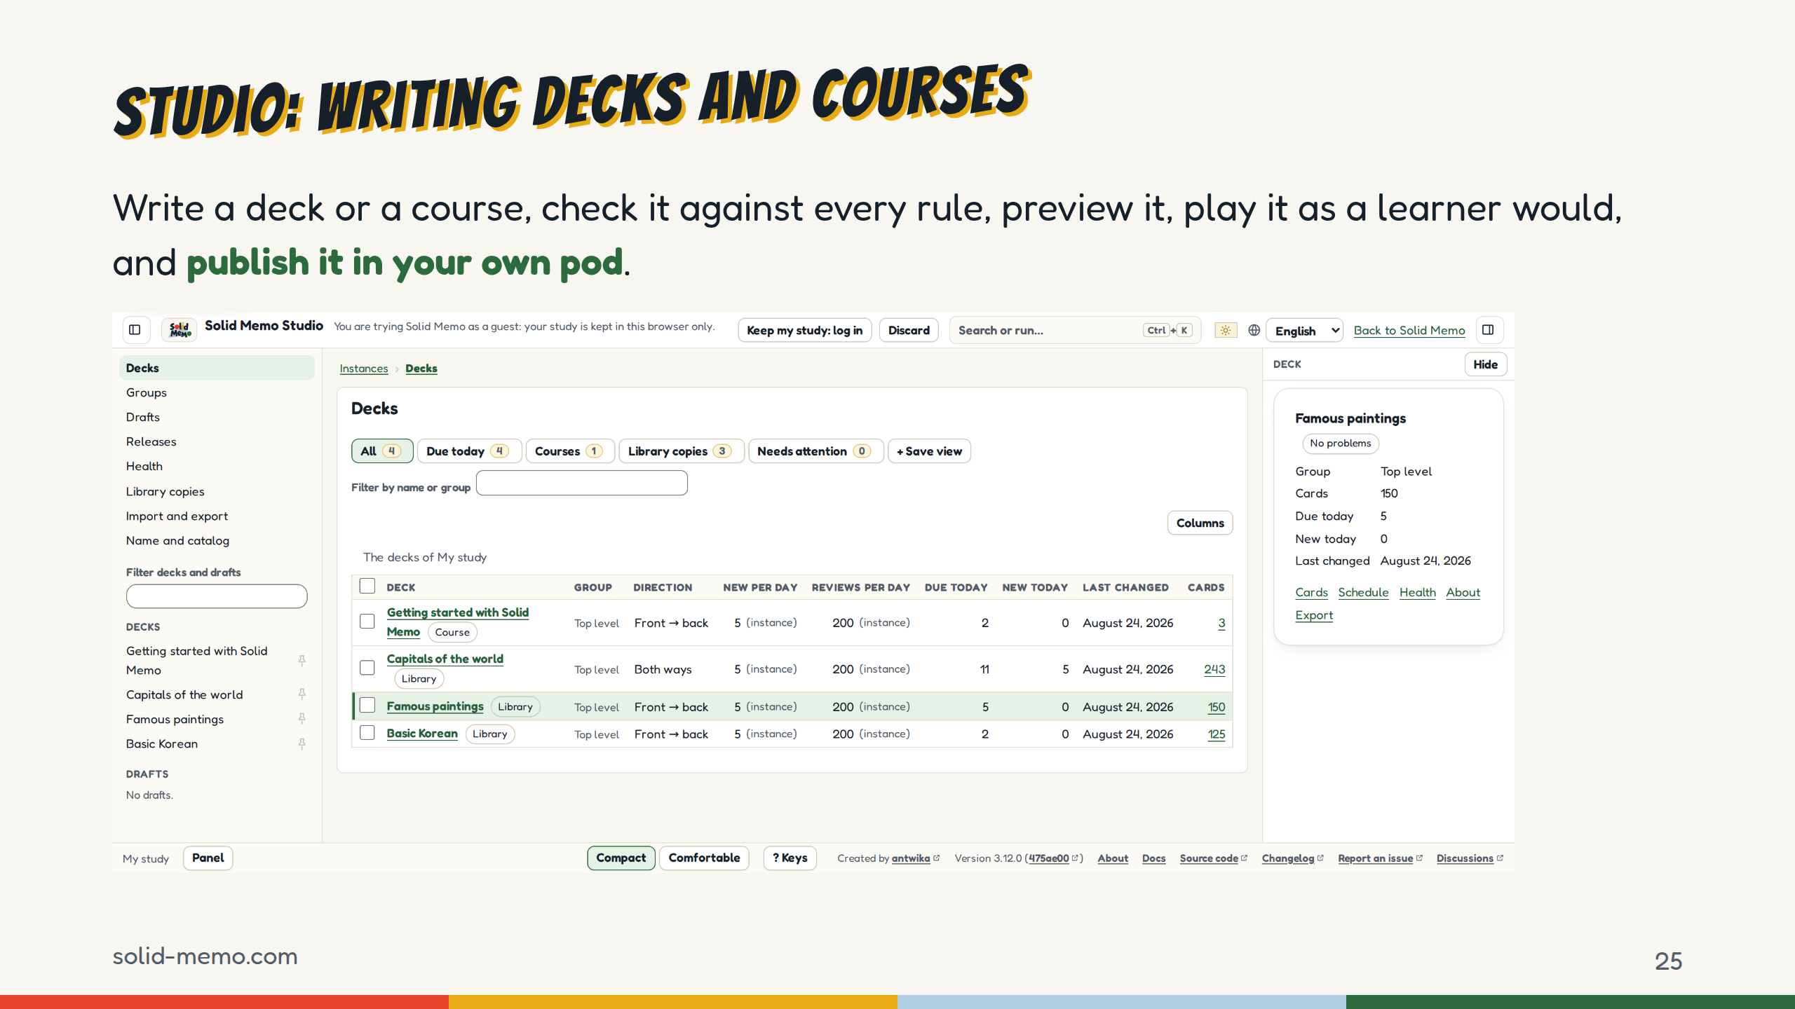
Notes:
Authors write in Solid Memo Studio, a second app in the same page, at solid-memo.com/#/studio.
A draft lives in your pod. You write it, check it against every rule the library holds a release to, preview it as the library will list it, play it in a sandbox as learners will, and compare it with the version before.
Then you publish it in your own pod, where anyone can read it, and a learner adds it by its link. Or you save it as a file and propose it for the library.
So even publishing a deck needs no server of mine.

Slide 26
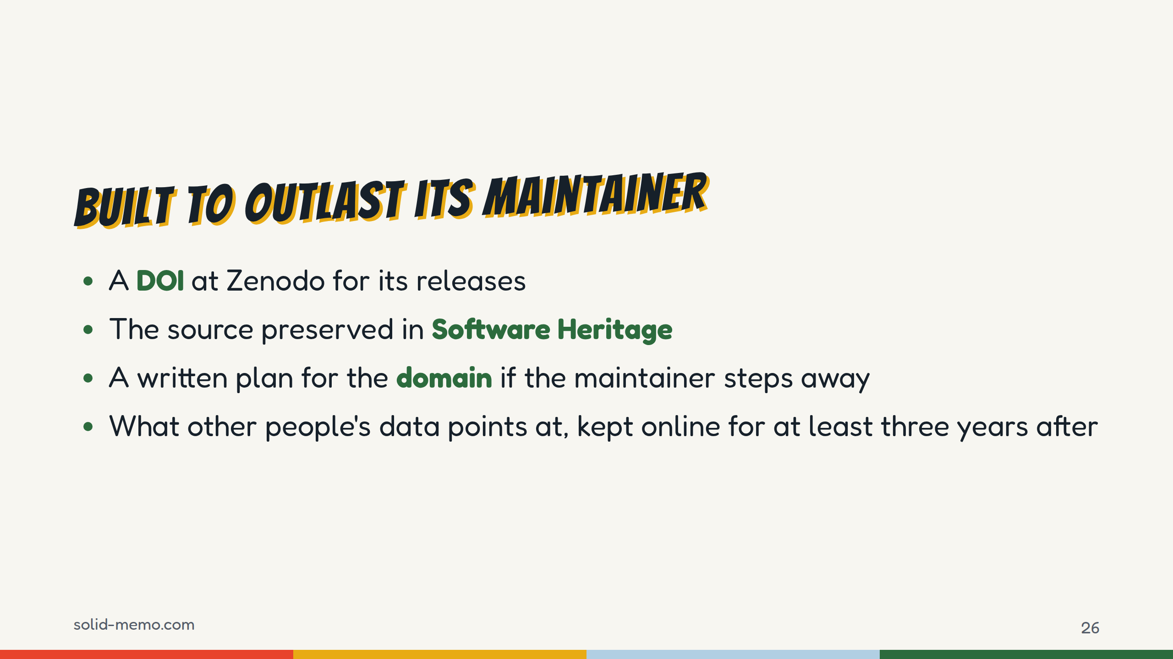
Notes:
If you're going to point at a project as a showcase, it should still be there in five years.
Zenodo archives the releases and gives each a DOI, with one DOI that always resolves to the latest. The source is preserved in Software Heritage.
The domain matters more than you'd think: people's pods hold data that points at solid-memo.com/ns and /decks. GOVERNANCE.md says what happens if I step away: the organization and the domain go to an active co-maintainer, or if there's none, the repository is archived and I keep the domain renewed, with the vocabulary and the decks still served, for at least three years.

Slide 27
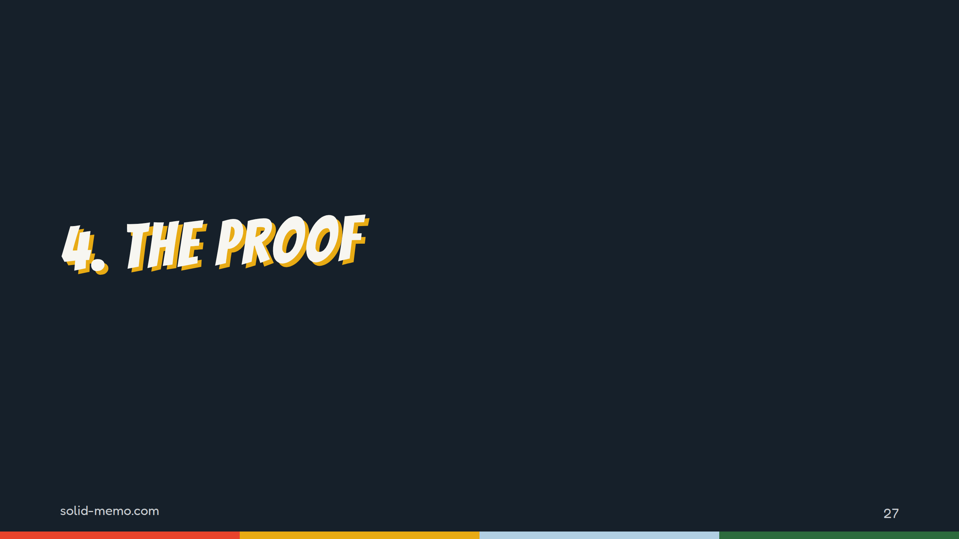
Notes:
Three promises made. Now, how do you know they hold up? This is the showcase part: the evidence.

Slide 28
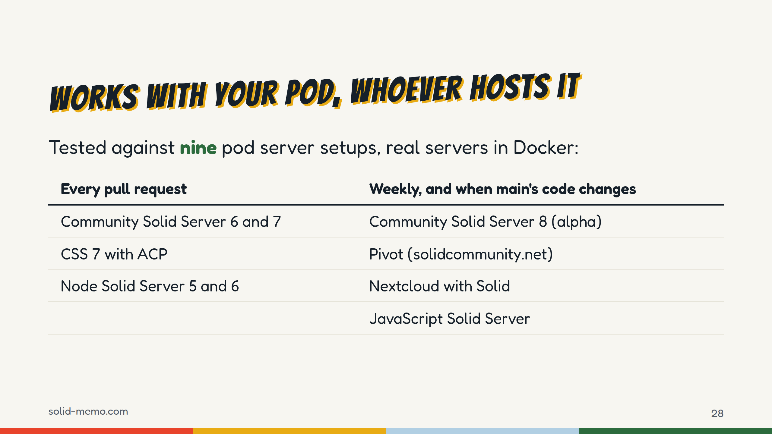
Notes:
Solid is a standard, and the app is only as good as the servers it meets. So every pull request runs the full suite against five real servers in Docker: Community Solid Server 6 and 7, CSS 7 with Access Control Policies instead of Web Access Control, and Node Solid Server 5 and 6. Those five block a merge.
Four more are advisory: CSS 8 alpha, Pivot, which is the server behind solidcommunity.net, Nextcloud with its Solid app, and the JavaScript Solid Server. They get a start-up check on every pull request, and the full suite weekly and whenever a push to main changes the app's code. Their failures are reported, not a gate.
Every server is pinned: the Community Solid Server images by digest, and the ACP setup on the same image; Node Solid Server, Pivot and JSS built in the repository from a lockfile, and Nextcloud's Solid app from a commit, all on base images pinned by digest.
Each advisory server keeps a list of the tests it fails, with the reason for each: JSS 78, Nextcloud 27. Pivot and the CSS 8 alpha pass everything.
Check the number of server setups again before the talk.

Slide 29
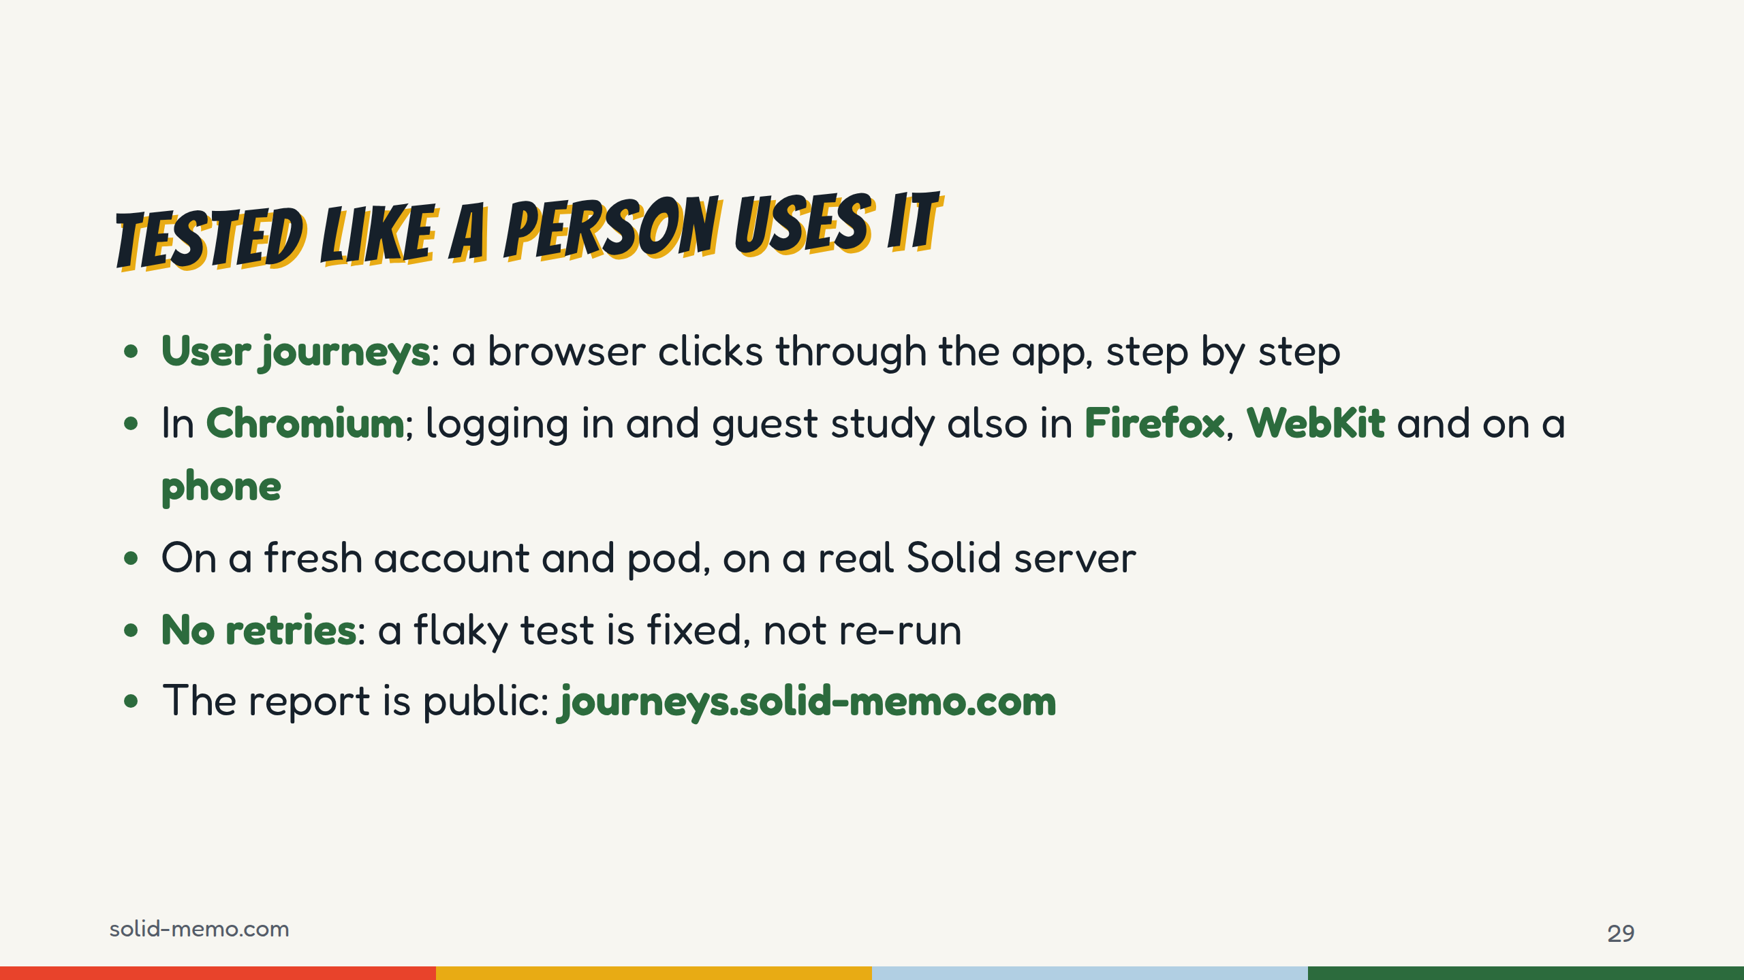
Notes:
Unit tests aren't enough for an app like this, so there are user journeys: Playwright drives a real browser through the app as a person would, against a real Community Solid Server, with a fresh account and pod each time.
All of them run in Chromium. The ones about logging in, guest storage and reloading also run in Firefox, WebKit and on an iPhone-sized phone.
No retries. If a journey is flaky, it gets fixed.
And you can open the report yourself at journeys.solid-memo.com and replay every click of the release you're using.

Slide 30
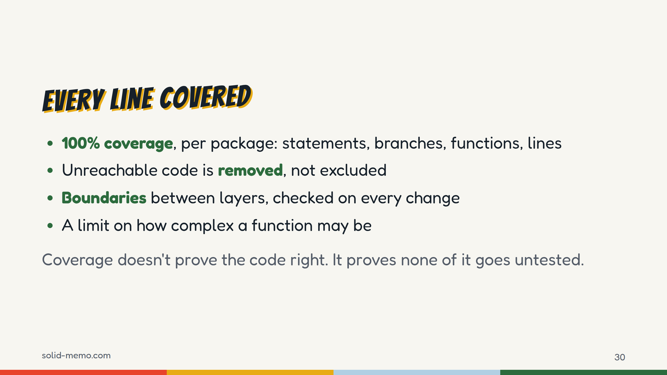
Notes:
Every package has 100% coverage of statements, branches, functions and lines, and each package's own tests cover its own code. The test run fails below that.
Code that can't be reached is removed, not excluded, and so is code only the tests use.
The layers have rules about who may import whom, and a check enforces them on every change. Biome caps cognitive complexity.
To be honest about what this means: coverage doesn't mean bug-free. It means nothing ships without a test running it. The real servers and the journeys are what catch the rest.

Slide 31
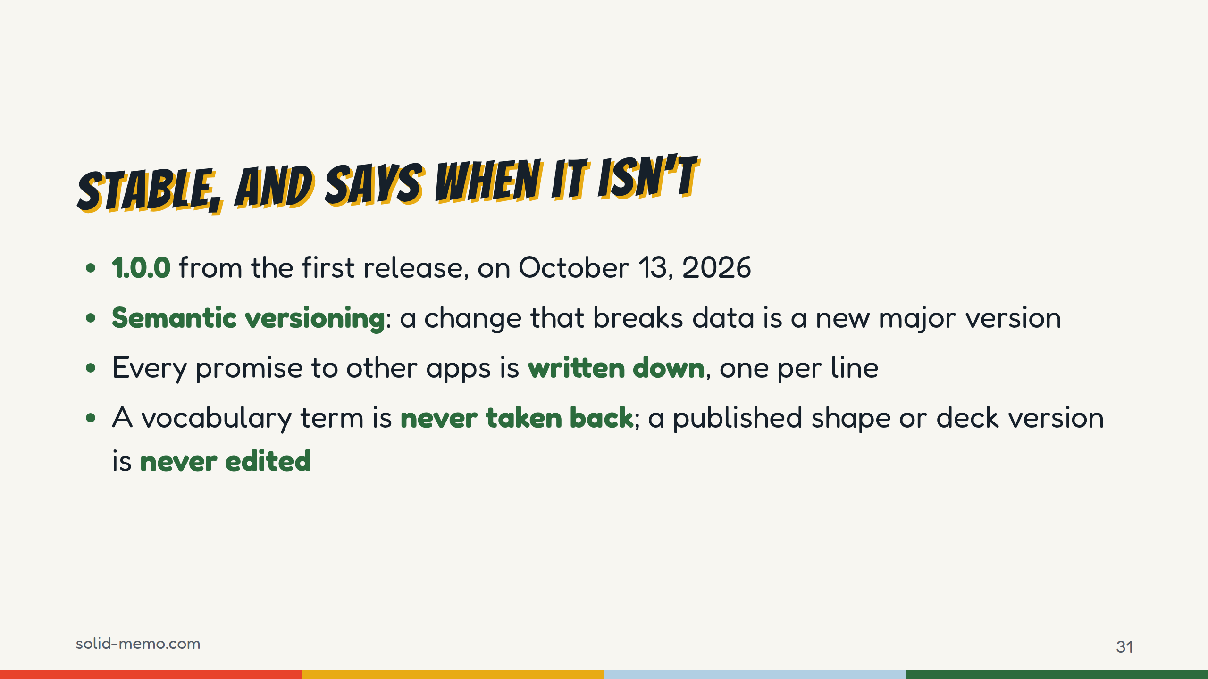
Notes:
Solid Memo was stable from its first release, 1.0.0, on October 13, 2026. Versions and the changelog are written by semantic-release from the commit messages.
Stable here doesn't mean nothing changes. It means a change that breaks the data formats is declared, and gets a new major version. Every promise to other apps, the formats, the pod layout, the routes, is written down in the repository, one per line, and CI fails if a line disappears without a commit saying it's breaking.
And what's published stays: a vocabulary term is never taken back, a shape or a deck version is never edited. Other people's data points at those addresses.

Slide 32
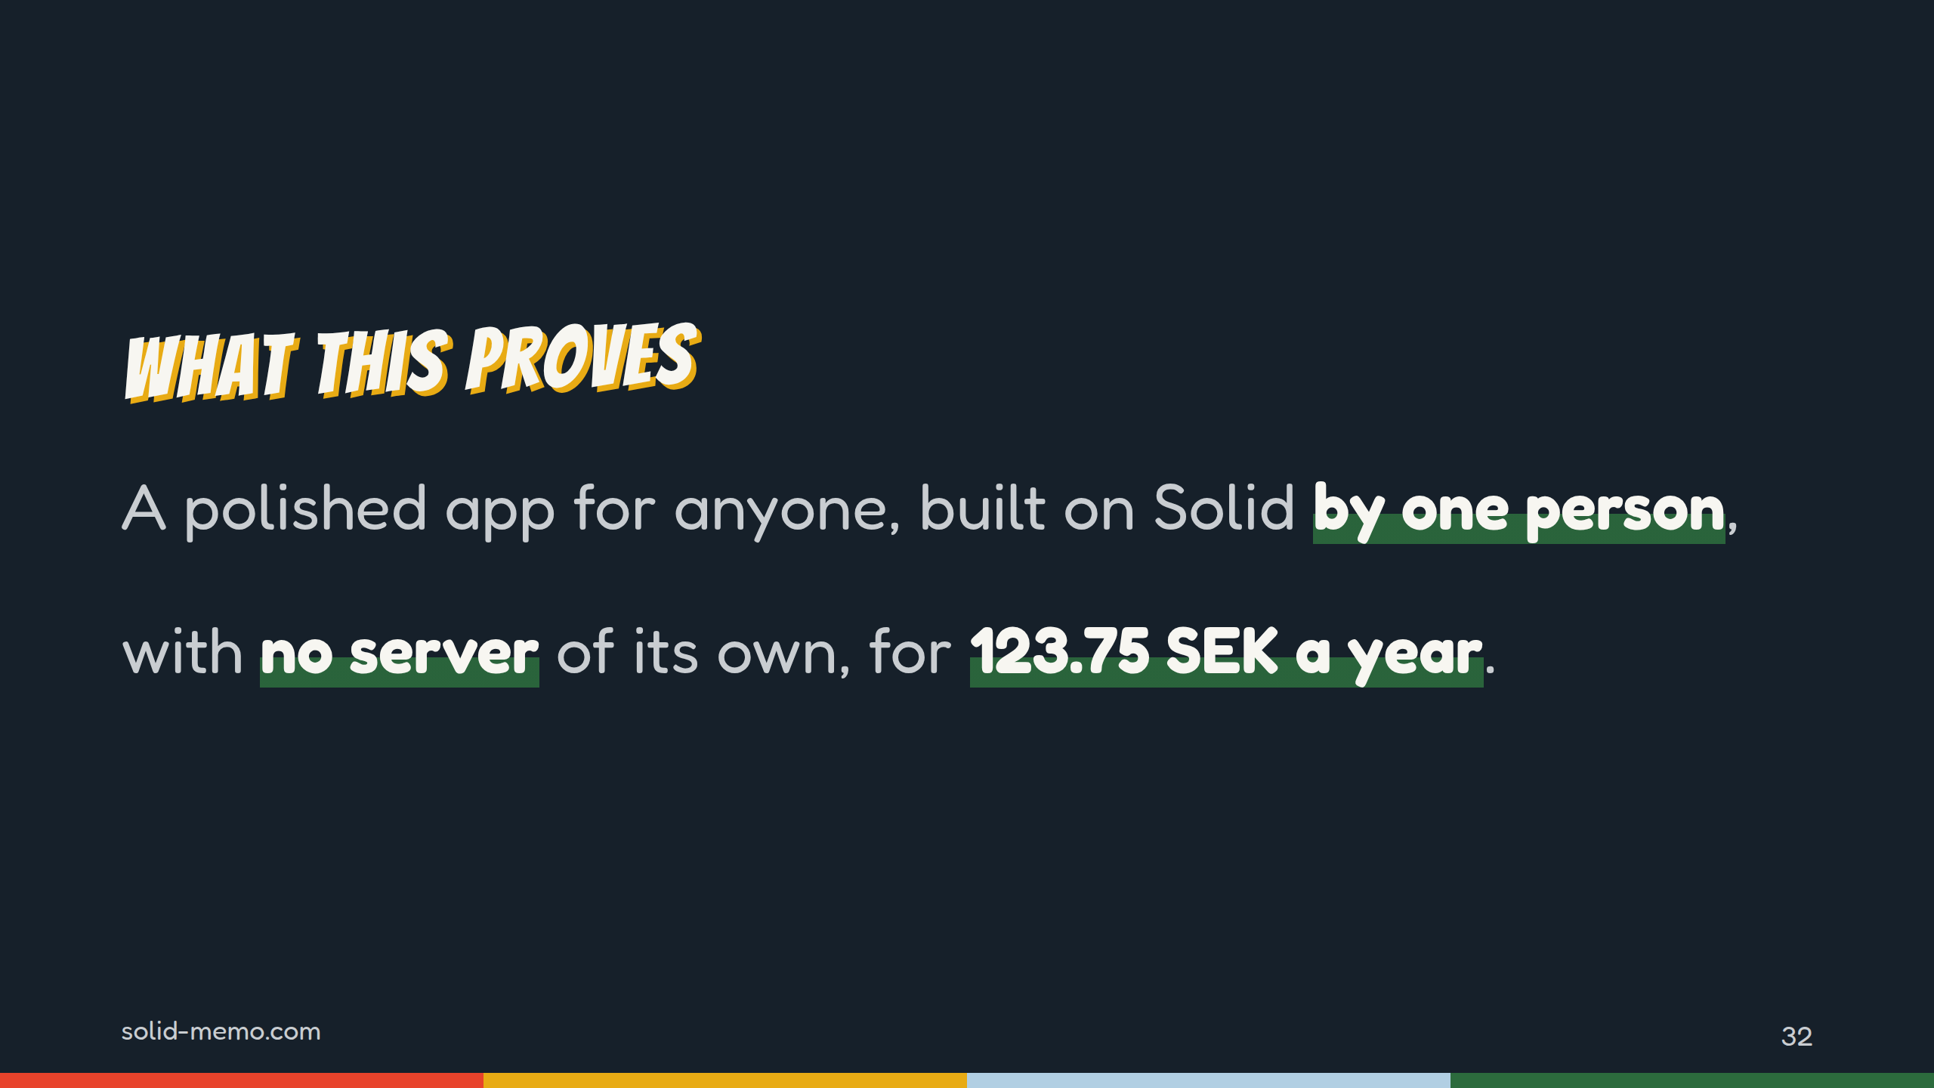
Notes:
Back to the question from the start: can Solid carry a polished app that anyone would use?
Here's my answer. One person built it. A learner can start with no account, in six languages, on a phone. It's tested against nine pod server setups, in three browser engines and on a phone, and it's stable, accessible by design, and open down to its decisions.
And it costs 123.75 kronor a year, because the users keep their own data.

Slide 33
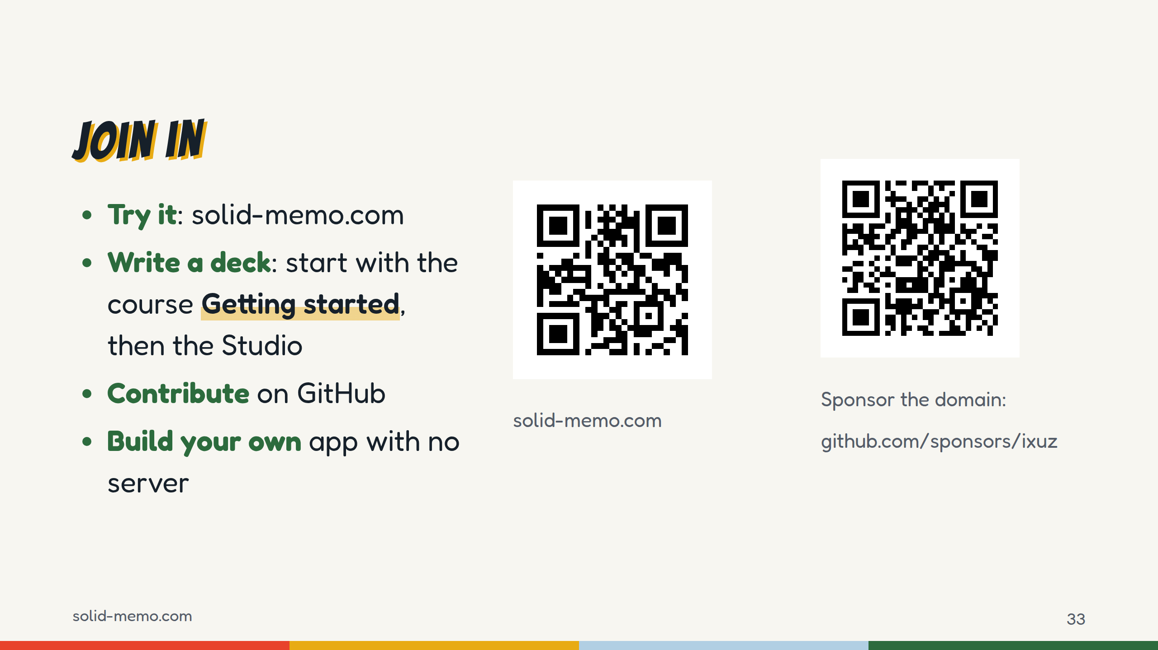
Notes:
Four ways in.
Try it: scan the first code. Press "Try it without logging in" and you're studying in seconds.
Write a deck: take the Getting started course, then open the Studio.
Contribute: bug reports and ideas, translations, decks, and interop reports from pod servers I don't test yet; there's an issue form for each. Everything is at github.com/solid-memo.
Or build your own app the same way: static files, the user's pod, no server.
And the second code: sponsor the domain. The sponsor page has been live since November 4, 2026, and GOVERNANCE.md says what donations pay for: the domain first, then the maintainer's time, and they buy no say over the roadmap. 123.75 kronor a year is the one thing that keeps Solid Memo depending on my wallet. Sponsoring it makes the app cost its maintainer nothing.

Slide 34
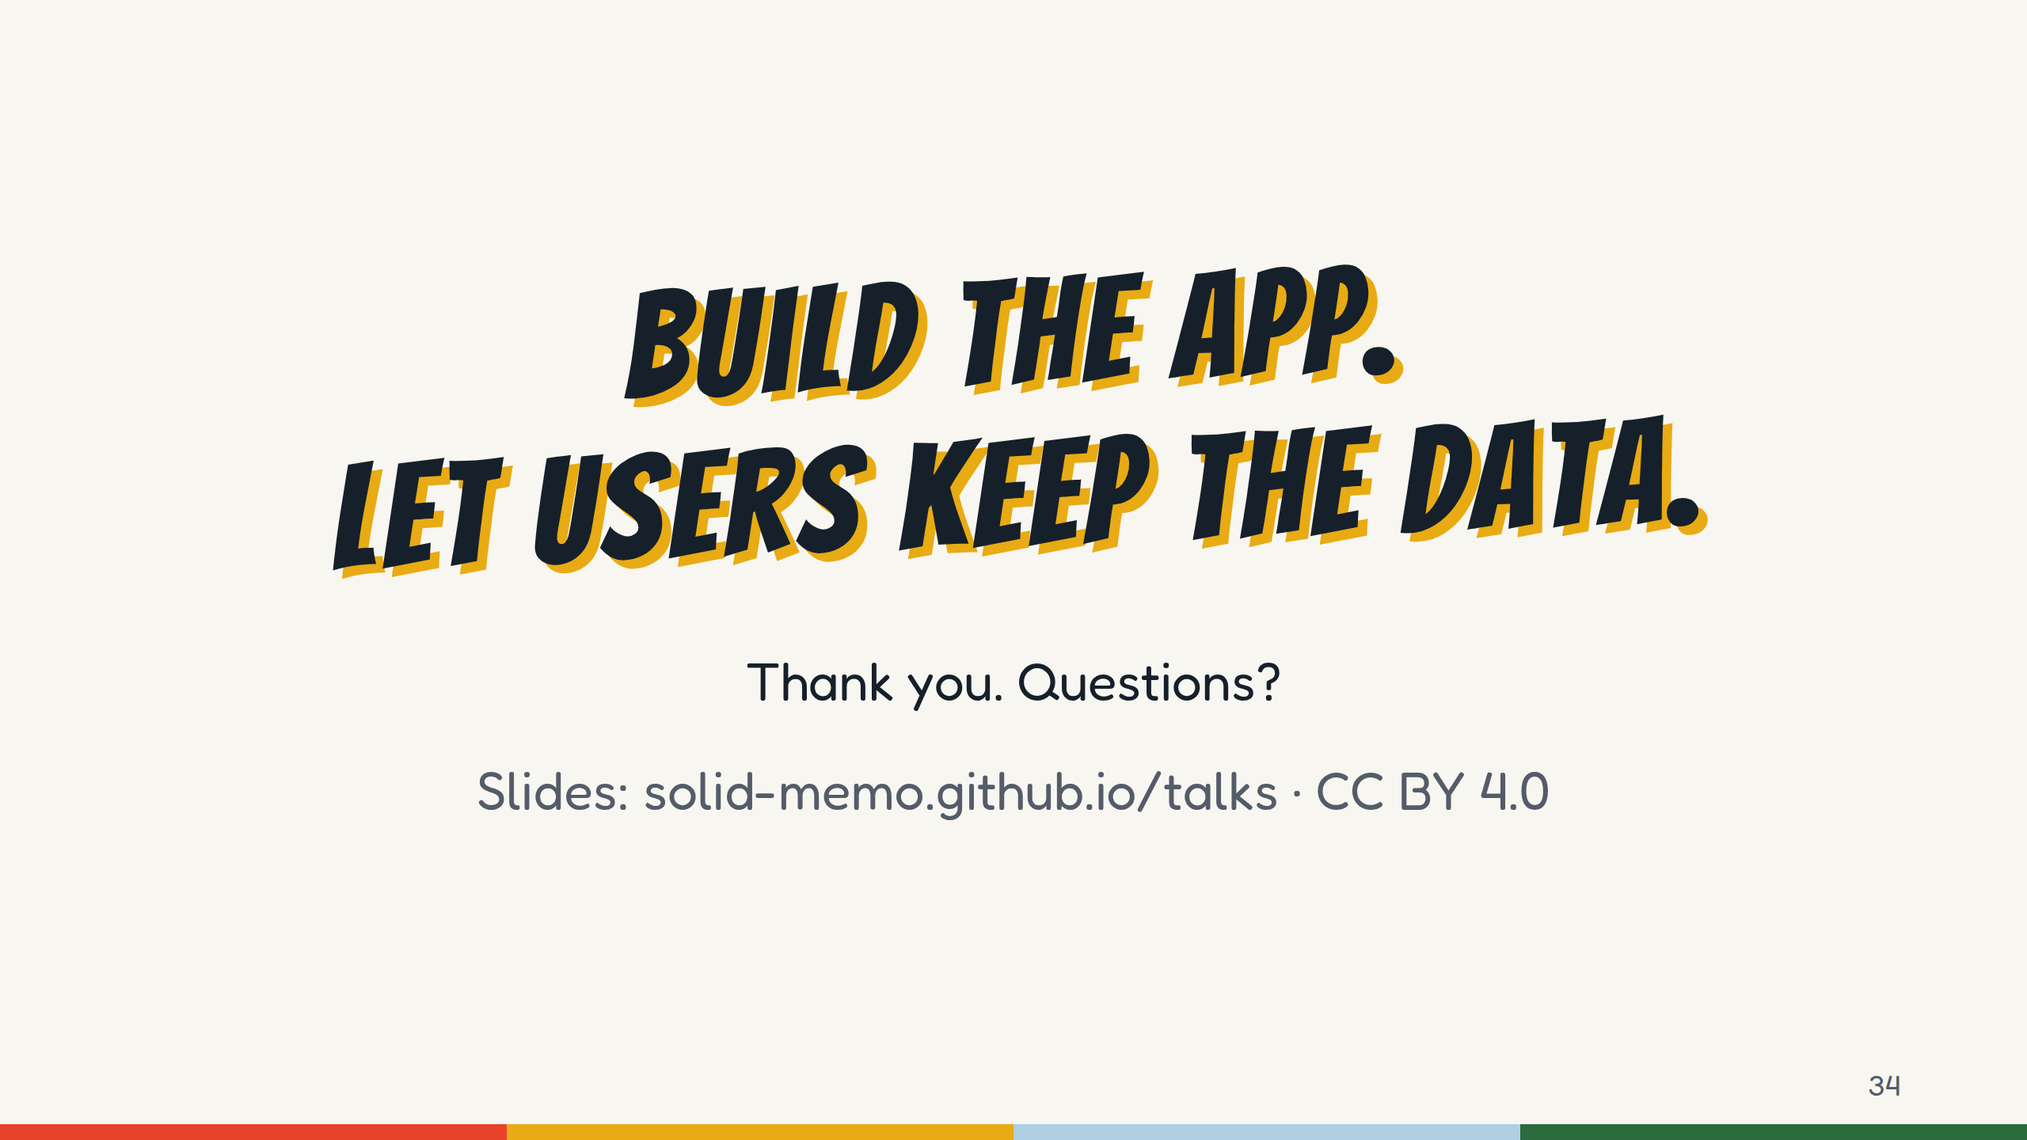
Notes:
That's the whole idea in one line: build the app, let users keep the data.
Thank you. Questions?
Questions people tend to ask, and short answers:
- "So there are servers after all?" Yes: GitHub Pages, your pod, your login provider. None of them is mine, and none keeps a copy of your study.
- "What if my pod provider closes?" Your data is RDF in documented, open formats, with the vocabulary and shapes published. You can copy it to another pod.
- "Offline? Reminders?" No service worker and no push: the app works while it's open.
- "Why not just localStorage?" Because then the data is stuck in one browser. Guest mode is exactly that, and it offers to move into a pod.
- "Bus factor?" One maintainer, and no funding beyond GitHub Sponsors, which opened in November 2026. There's a written plan for stepping away, in GOVERNANCE.md.

